Slide 1

Loan Default Dataset Analysis
An in-depth look at the factors that predict loan default risk using real-world data and machine learning models.
BY :
MARIAM MOHAMED
MALK EMAD
BARAA MAGDY
TALAL ORABY

Slide 2
What Is Loan Default?
Loan default occurs when a borrower fails to make required payments on a debt according to the agreed-upon terms. This is a major concern for financial institutions as it can lead to significant financial losses and impact their stability.

Slide 3
Dataset Overview
Our analysis uses a Kaggle dataset containing real-world loan information. This provides a robust foundation for building predictive models.
10+
0 / 1
Entries
Features
Target Variable
A large sample size ensures statistical significance.
Rich data including income, credit score, and loan amount.
Binary classification: 1 for paid ,and 0 defaulted

Slide 4
Exploring Key Features
The dataset includes a mix of numerical and categorical variables that provide a comprehensive view of each borrower.
Borrower Information
Loan Details
Age & Annual Income
Loan & Funded Amount
Employment Length
Interest Rate & Term
Debt-to-Income Ratio
Number of Credit Lines
Verification Status
Credit Score

Slide 5
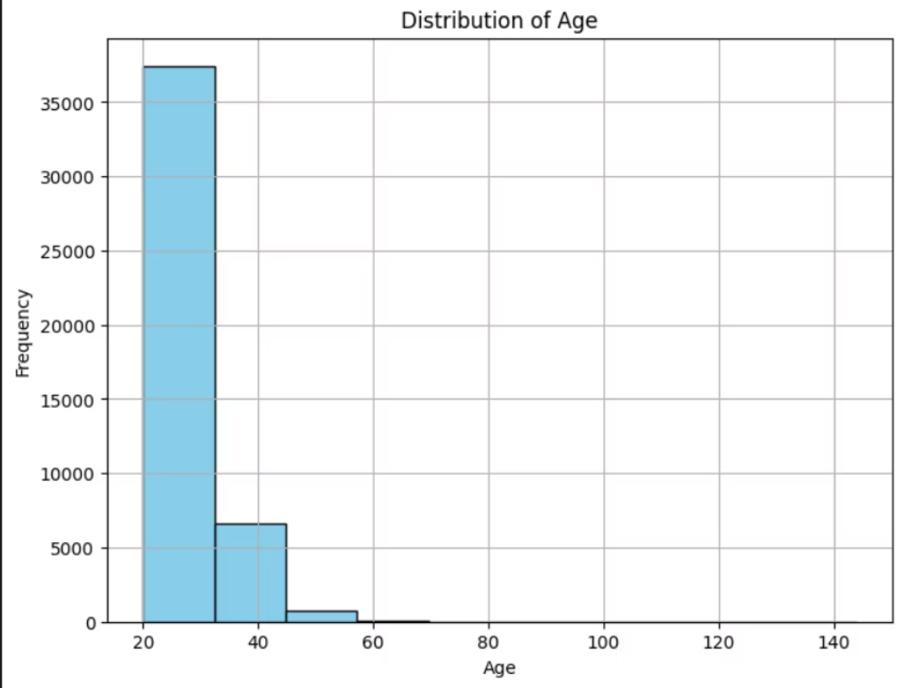
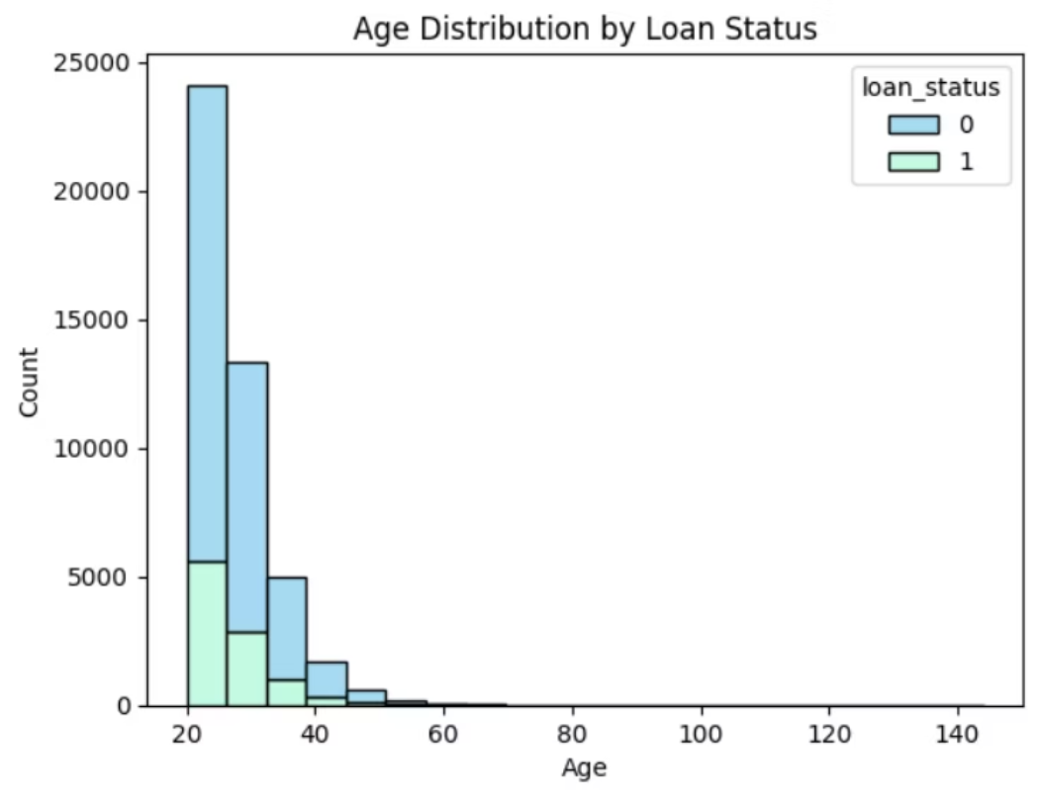
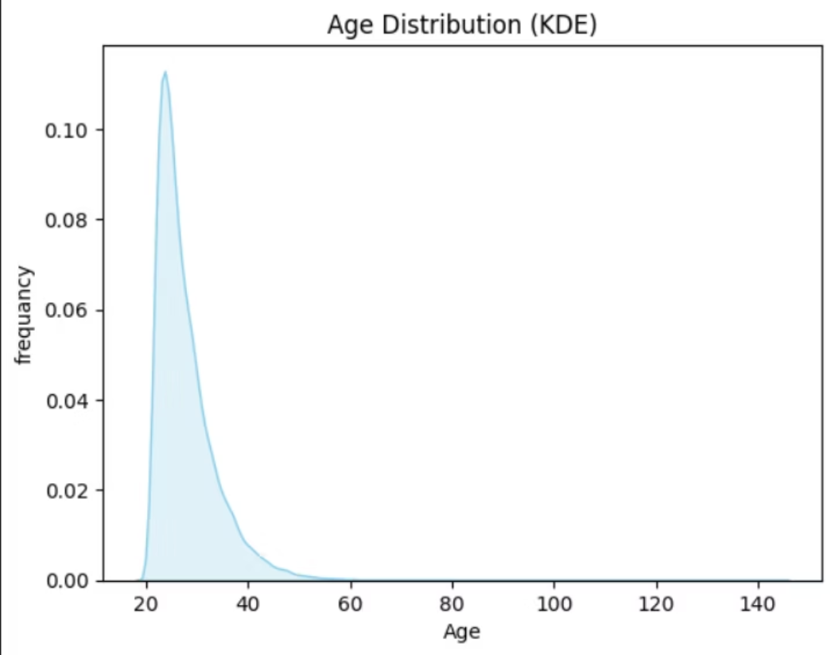
AGE DISTRIBUTION :
HISTOGRAM
HISTOGRAM OF AGE AND LOAN STATUS
KDE
DISTRIBUTION OF AGE SHOWS THAT MOST APPLICANTS ARE 20~32 YEARS OLD
DISTRIBUTION BETWEEN AGE AND LOAN STATUS SHOWS THAT MOST APPLICANTS AT THE AGE OF 20~32 UNFORTUNATLY COULD NOT REPAY THE LOAN

Slide 6
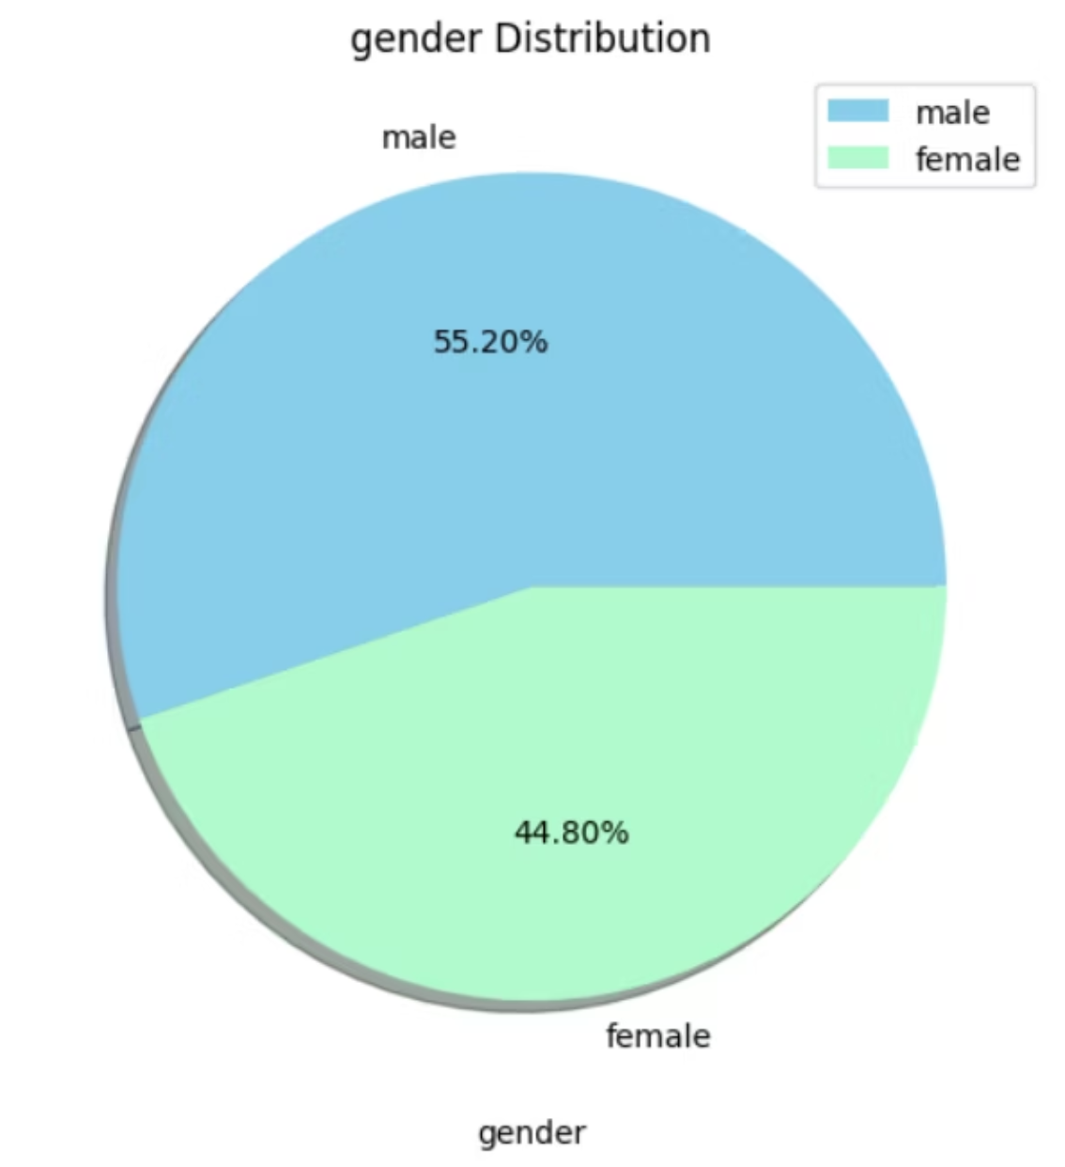
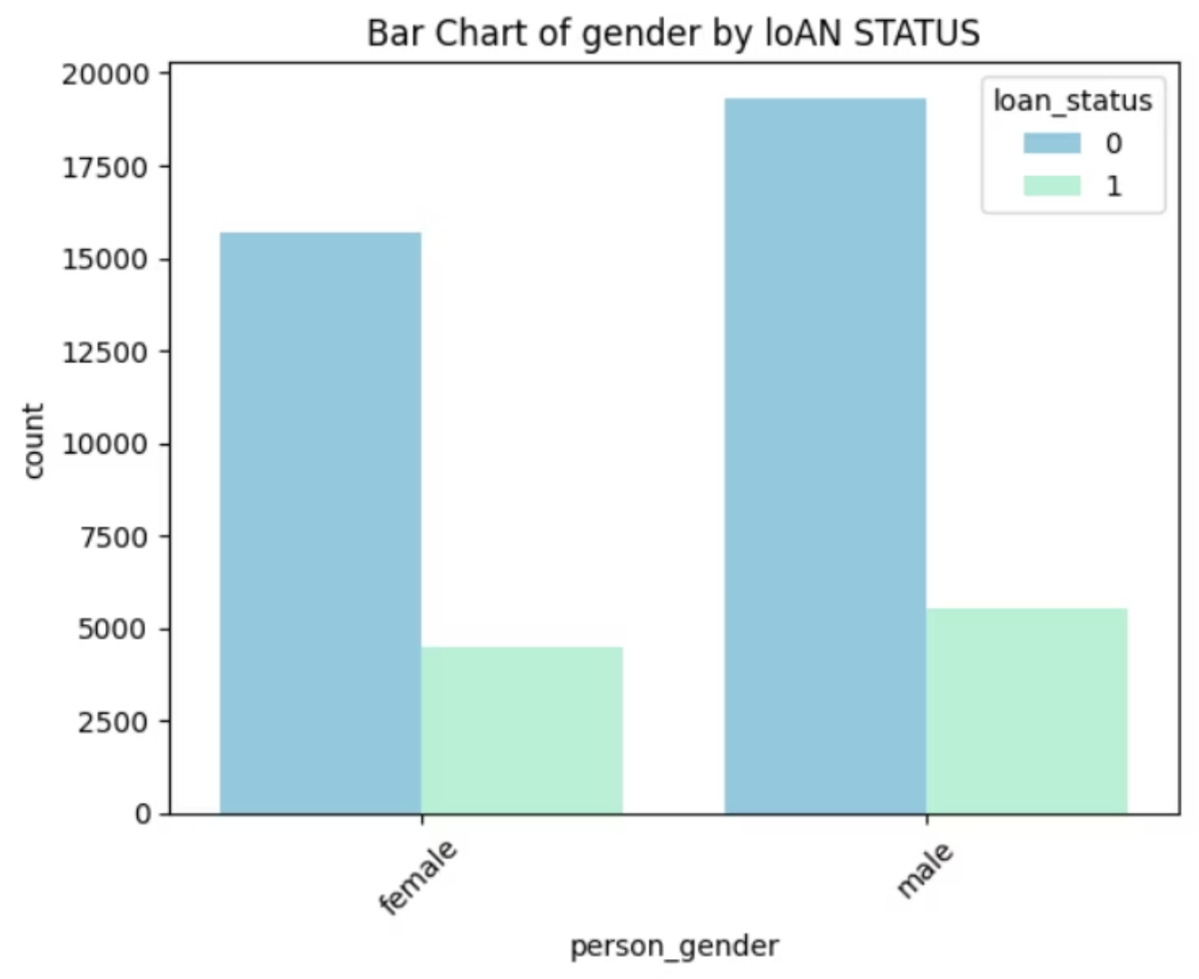
GENDER DISTRIBUTION :
BAR CHART
PIE CHART
BETWEEN GENDER AND LOAN STATUS
DISTRIBUTION BETWEEN GENDER AND LOAN STATUS SHOWS THAT MALES HAVE A HIGHER CHANCE OF NOT REPAYING THE LOAN
DISTRIBUTION OF GENDER SHOWS THAT MALES TEND TO HAVE A WIDER RANGE OF APPLICANTS BUT NOT VERY WIDE

Slide 7
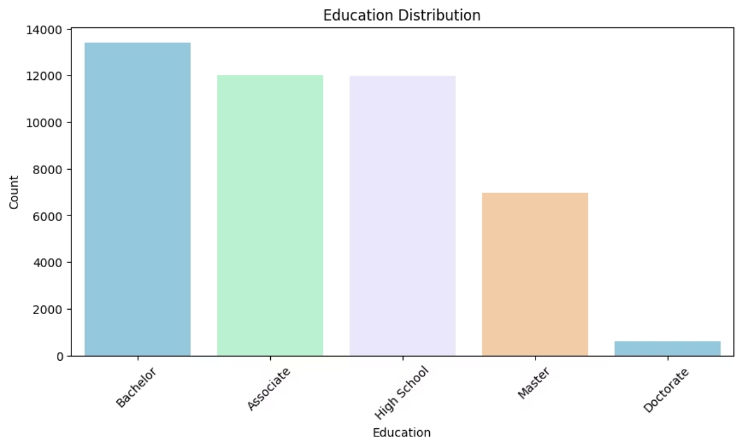
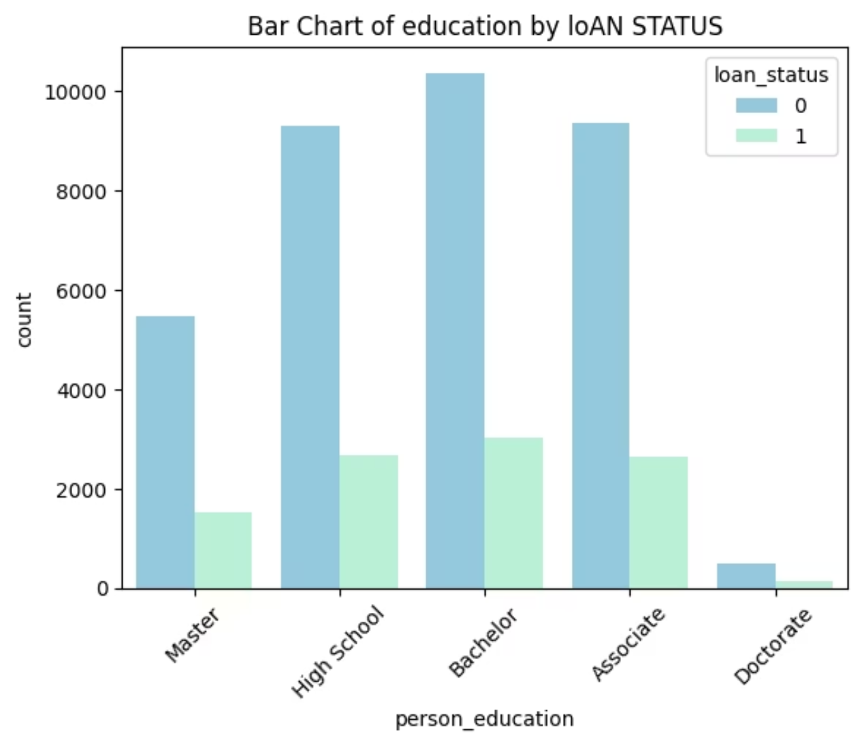
EDUCATION DISTRIBUTION :
BAR CHART
DISTRIBUTION OF EDUCATION SHOWS THAT MOST APPLICANTS EDUCATIONAL BACKGROUND 1. BACHELOR FOLLOWED BY (ASSOCIATE AND HIGH SCHOOL)
BAR CHART
BETWEEN EDUCATION AND LOAN STATUS
DISTRIBUTION BETWEEN EDUCATION AND LOAN STATUS SHOWS THAT MOST APPLICANTS WITH BACHELOR EDUCATIONAL BACKGROUND UNFORTUNATLY COULD NOT REPAY THE LOAN AND ALSO THERE IS A VERY HIGH CHANCE OF NOT REPAYING AT APPLICANTS WITH ASSOCIATE AND HIGH SCHOOL EDUCATIONAL BACKGROUND

Slide 8
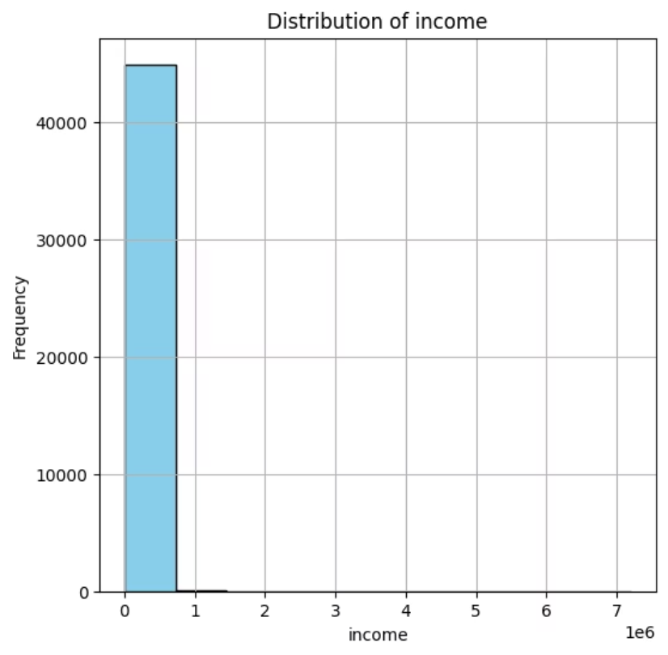
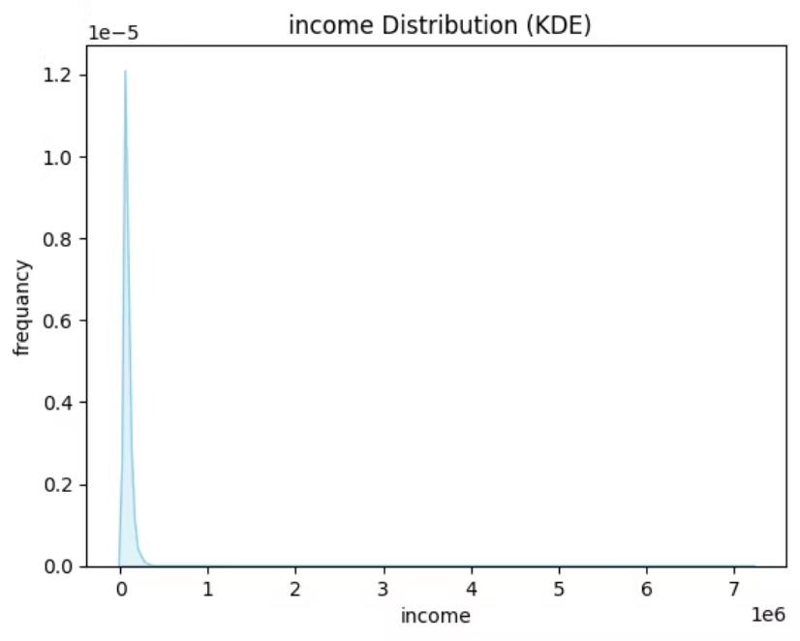
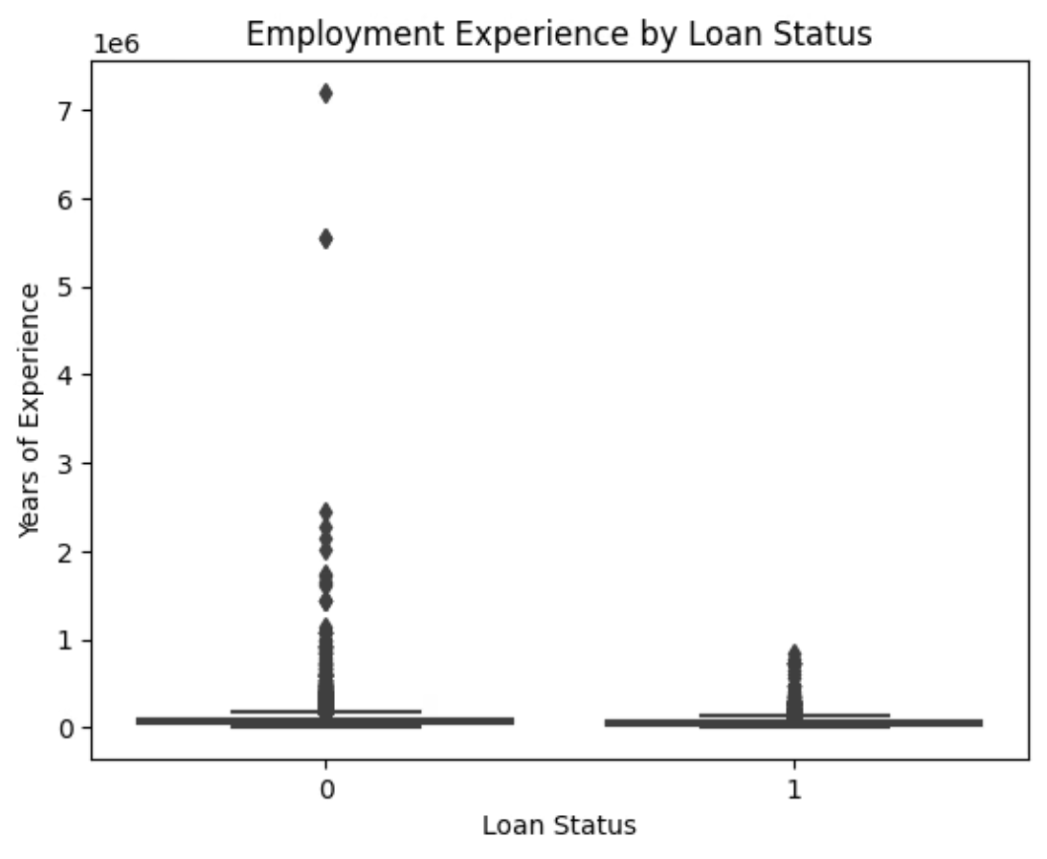
INCOME DISTRIBUTION :
KDE
HISTOGRAM
DISTRIBUTION OF INCOME SHOWS THAT MOST APPLICANTS HAVE AN INCOME OF 800,000
BOX PLOT
BETWEEN INCOME AND LOAN STATUS
DISTRIBUTION BETWEEN INCOME AND LOAN STATUS SOME APPLICANTS HAVE EXTREMELY HIGH INCOME VALUES (like 5–7 million), WHICH ARE LIKELY EXTREME OUTLIERS

Slide 9
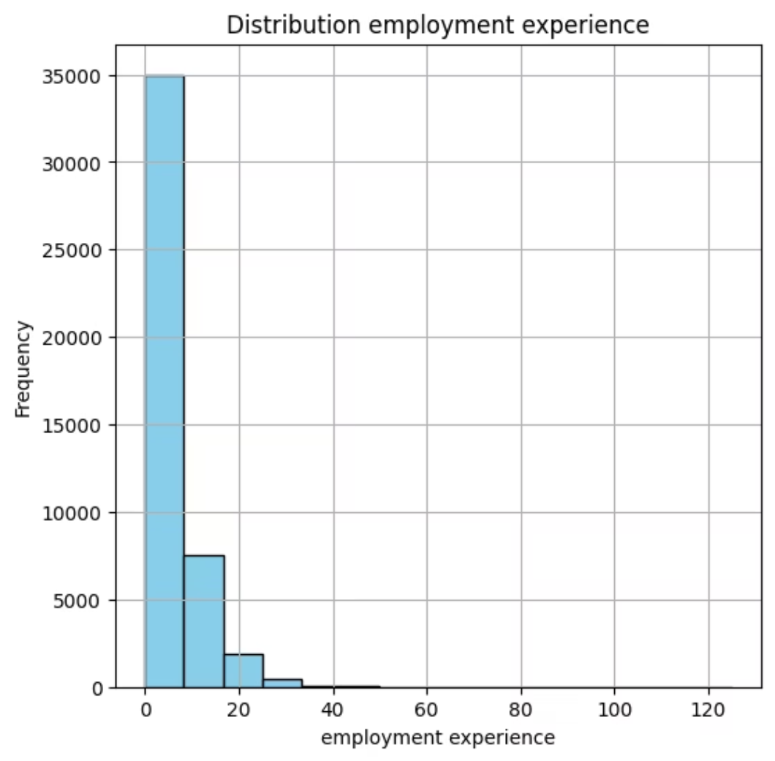
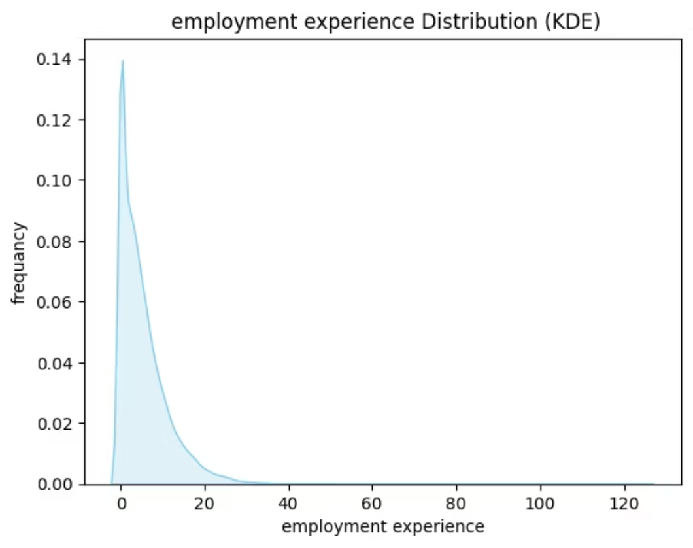
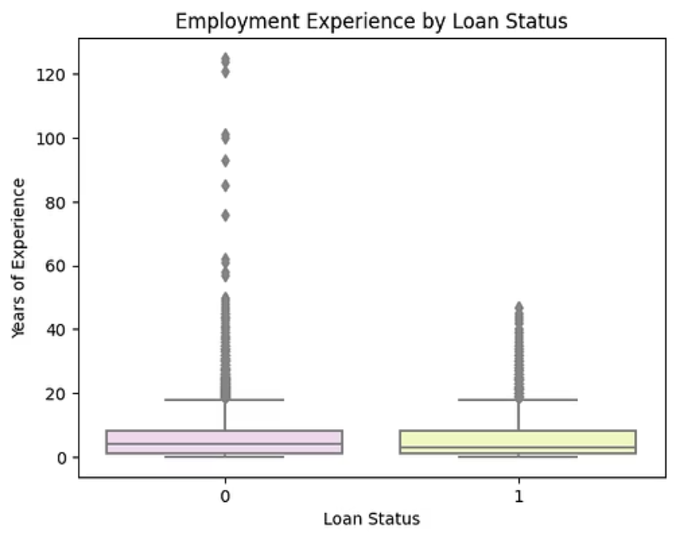
EMPLOYMENT EXPERIENCE :
BOX PLOT
KDE
BETWEEN EXPERIEMENT AND LOAN STATUS
DISTRIBUTION BETWEEN YEARS OF EXPERIENCE AND LOAN STATUS SHOWS THAT YEARS OF EXPERIENCE GENERAL DISTRIBUTIONIS IS SIMILAR FOR BOTH LOAN STATUS GROUPS
HISTOGRAM
DISTRIBUTION OF YEARS OF EXPERIENCE SHOWS THAT MOST APPLICANTS HAVE 10 YEARS OF EXPERIENCE

Slide 10
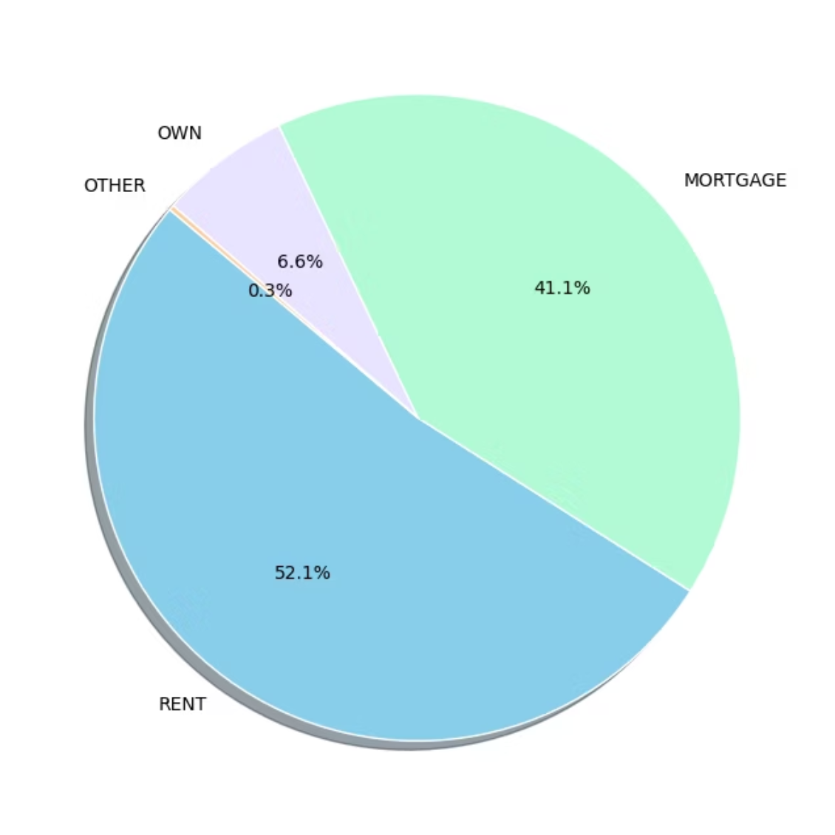
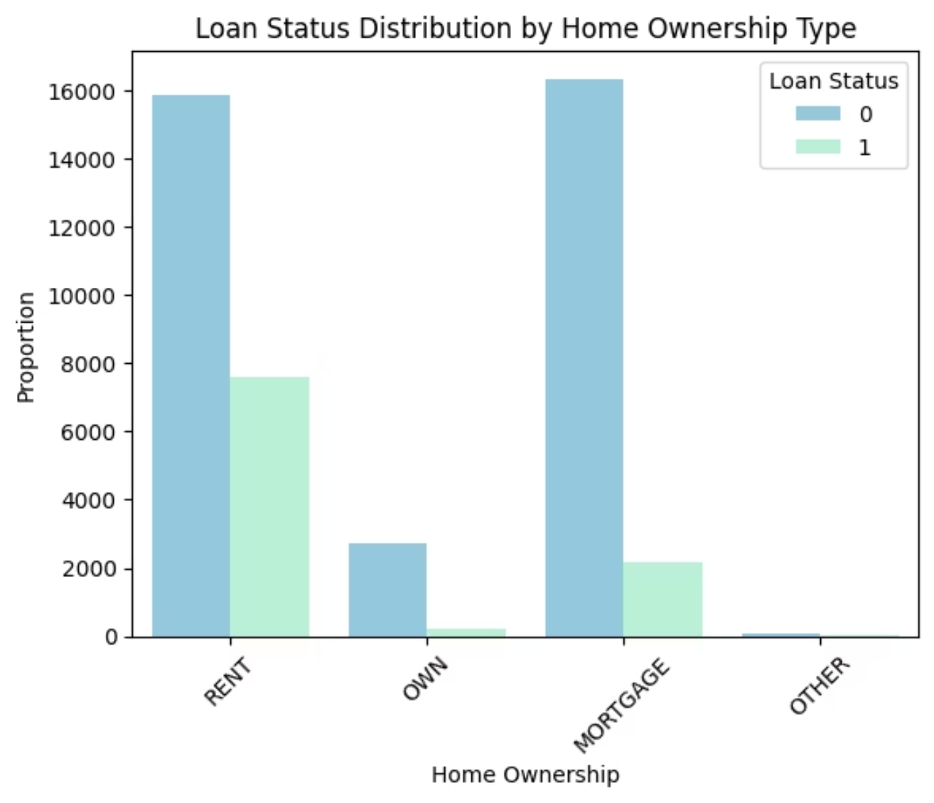
TYPE OF OWNERSHIP :
PIE CHART
BAR CHART
DISTRIBUTION OF TYPE OF HOME OWNERSHIP SHOWS THAT RENT IS THE MOST TYPE OF HOME OWNERSHIP
BETWEEN OWNERSHIP AND LOAN STATUS
DISTRIBUTION BETWEEN TYPE OF HOME OWNERSHIP AND LOAN STATUS SHOWS THAT APPLICANTS WITH THE MORTGAGE HAVE A VERY HIGH CHANCE OF NOT REPAYING THE LOAN FOLLOWED BY APPLICANTS WITH RENT TYPE

Slide 11
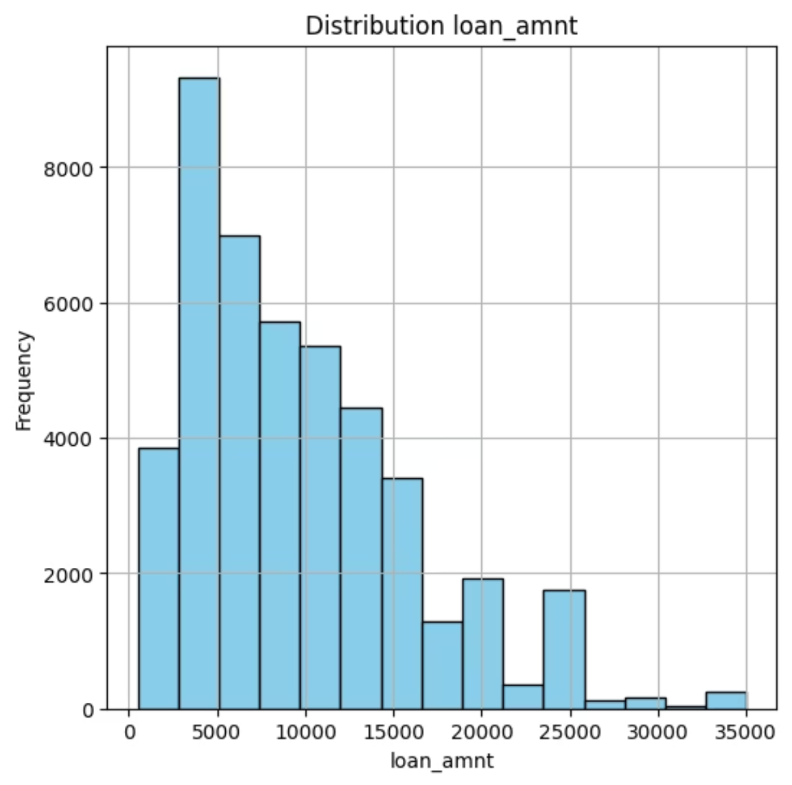
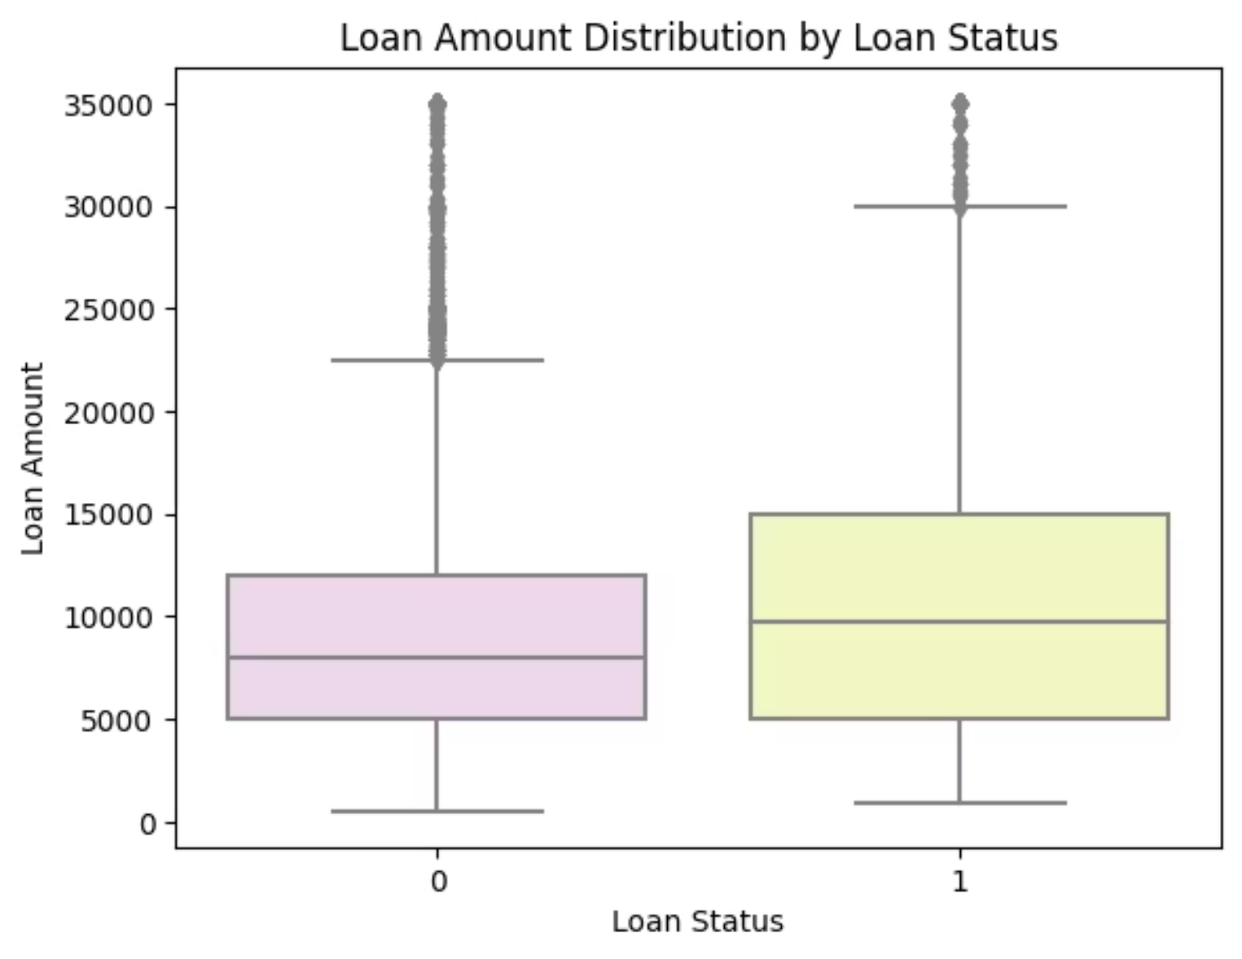
LOAN AMOUNT DISTRIBUTION :
HISTOGRAM
BOX PLOT
DISTRIBUTION OF LOAN AMOUNT SHOWS THAT MOST APPLICANTS GOT LOANS IN RANGE FROM 2500 ~5000
BETWEEN LOAN AMOUNT AND LOAN STATUS
DISTRIBUTION BETWEEN LOAN AMOUNT AND LOAN STATUS SHOWS THAT LARGER LOAN AMOUNTS DO NOT NECESSARILY LEAD TO DEFAULT ( MANY HIGH AMOUNT LOANS WERE NOT DEFAULTED)

Slide 12
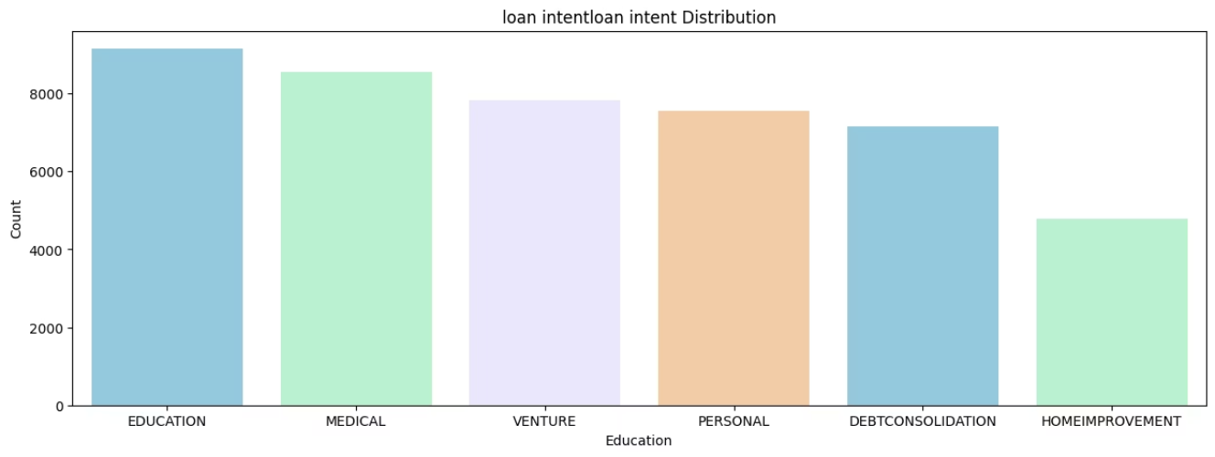
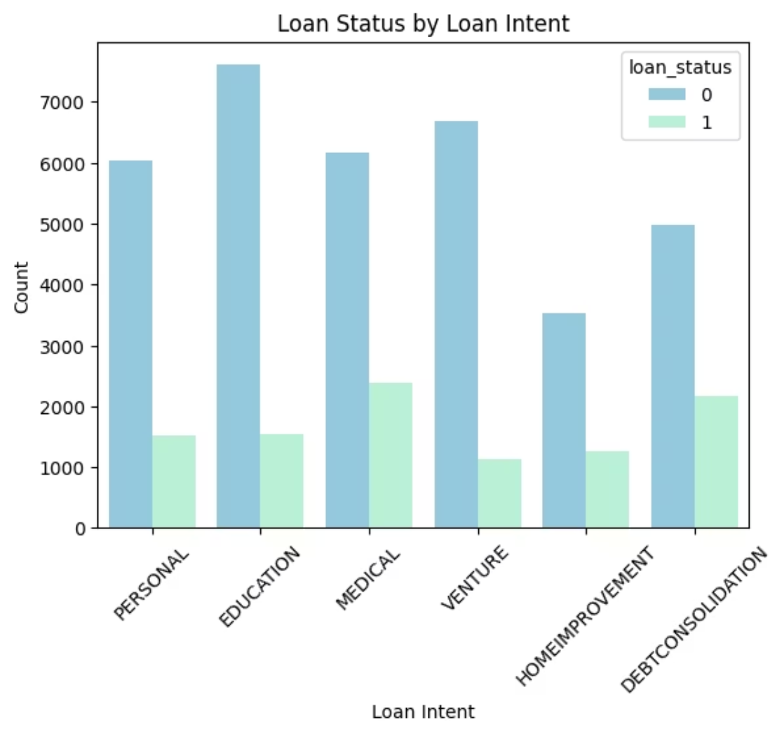
LOAN PURPOSE DISTRIBUTION :
BAR CHART
DISTRIBUTION OF PURPOSE OF LOAN SHOWS THAT THE MOST COMMON PURPOSE IS EDUCATION
BAR CHART
BETWEEN LOAN PURPOSE AND LOAN STATUS
DISTRIBUTION BETWEEN PURPOSE OF LOAN AND LOAN STATUS SHOWS THAT MOST OF APPLICANTS THAT HAD LOANS BECAUSE OF EDUCATION COULD NOT REPAY THE LOAN

Slide 13
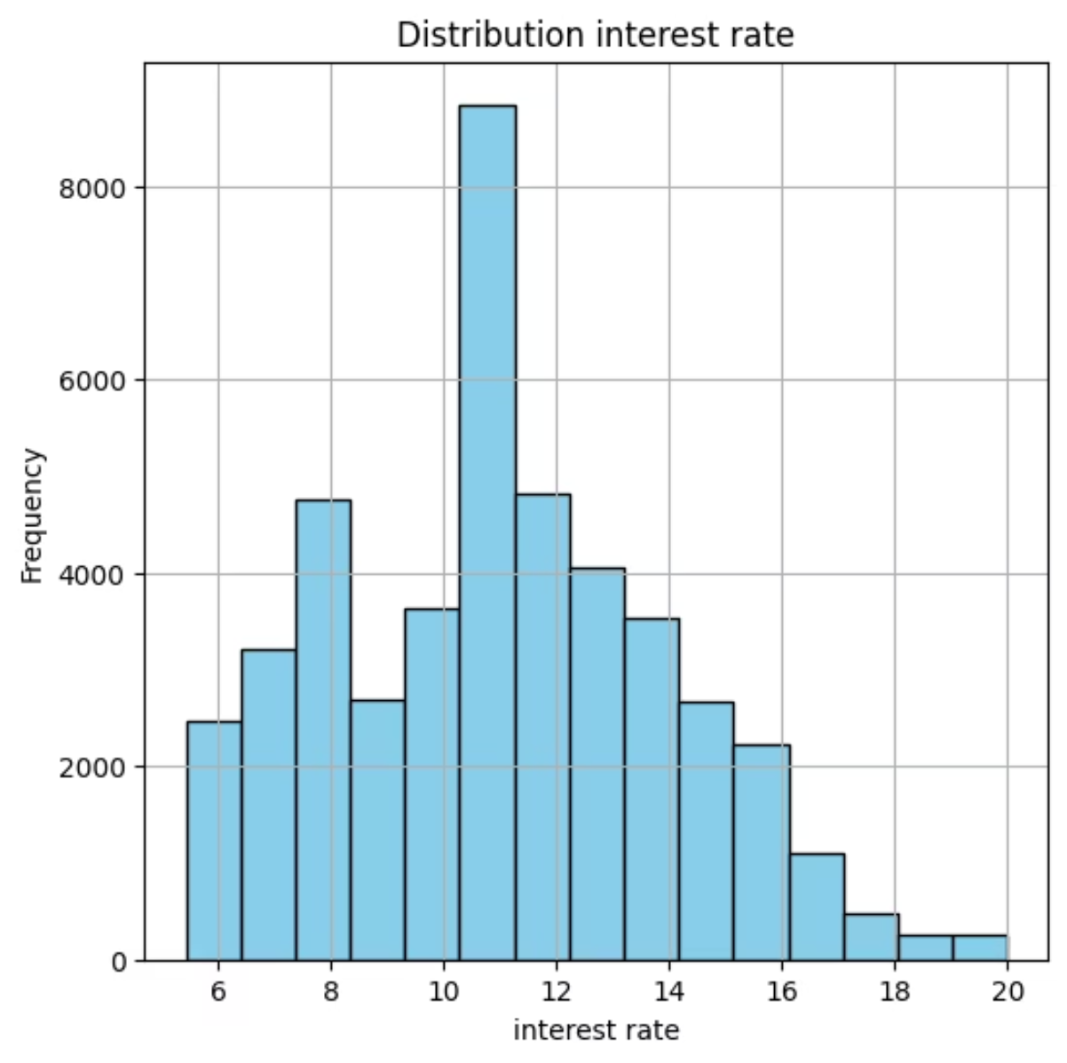
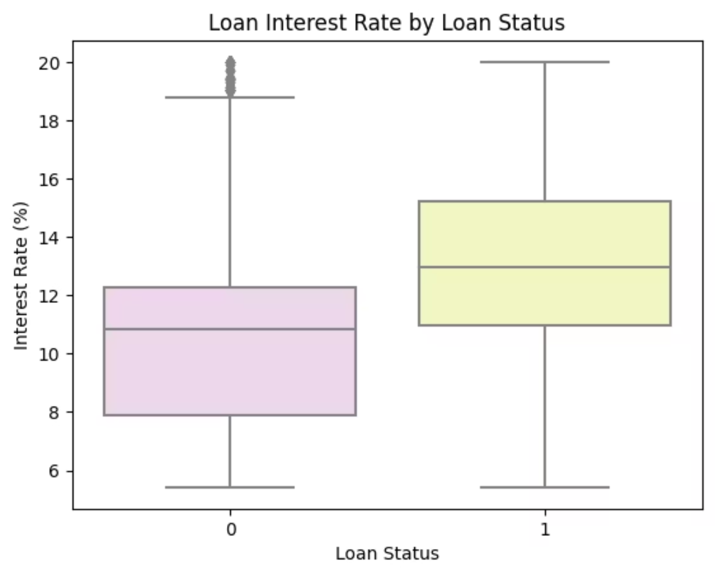
INTEREST RATE DISTRIBUTION :
HISTOGRAM
BOX PLOT
DISTRIBUTION OF INTEREST RATE ON THE LOAN SHOWS THAT MOST APPLICANTS HAD AN INTEREST RATE ON THE LOAN FROM 10~12 %
DISTRIBUTION BETWEEN INTEREST RATE ON THE LOAN AND LOAN STATUS SHOWS THAT APPLICANTS WITH HIGH INTEREST RATE COULD REPAY THE LOAN SUCCESSFULLY

Slide 14
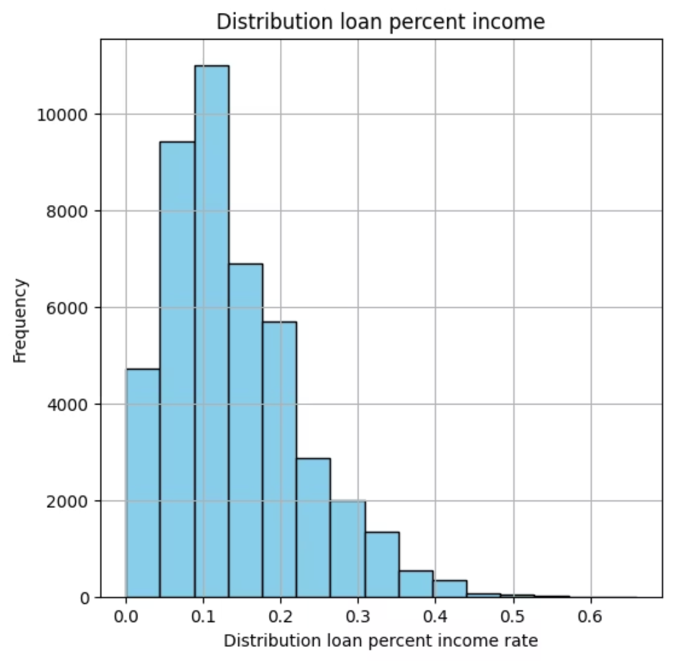
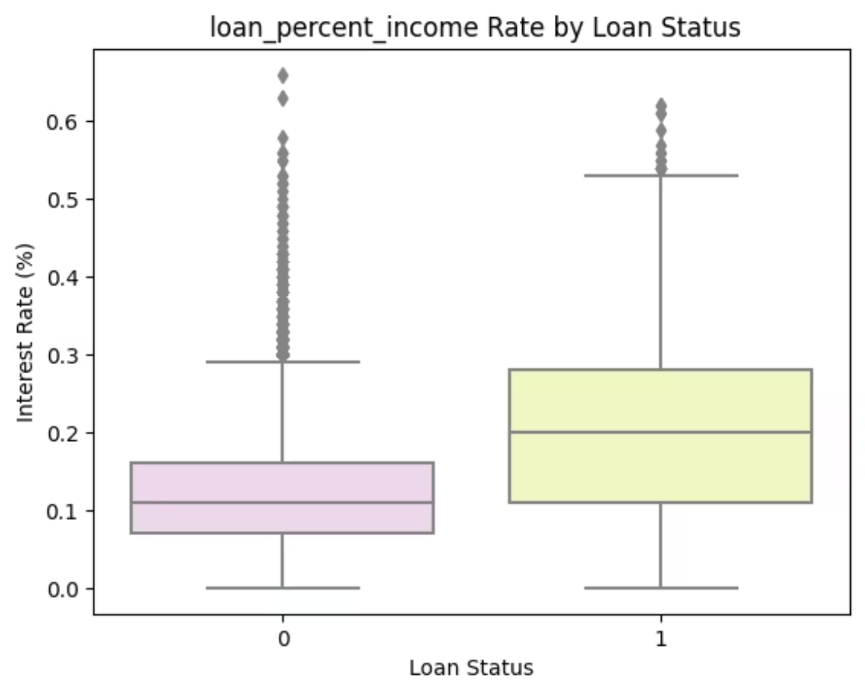
INCOME RATE DISTRIBUTION :
HISTOGRAM
BOX PLOT
DISTRIBUTION OF RATIO OF LOAN AMOUNT TO INCOME SHOWS THAT THE MOST COMMON RANGE IS FROM 0.05~0.12
BETWEEN INCOME RATE AND LOAN STATUS
DISTRIBUTION BETWEEN RATIO OF LOAN AMOUNT TO INCOME AND LOAN STATUS SHOWS THAT HIGHER RANGES REPAIED SUCCESSFULLY

Slide 15
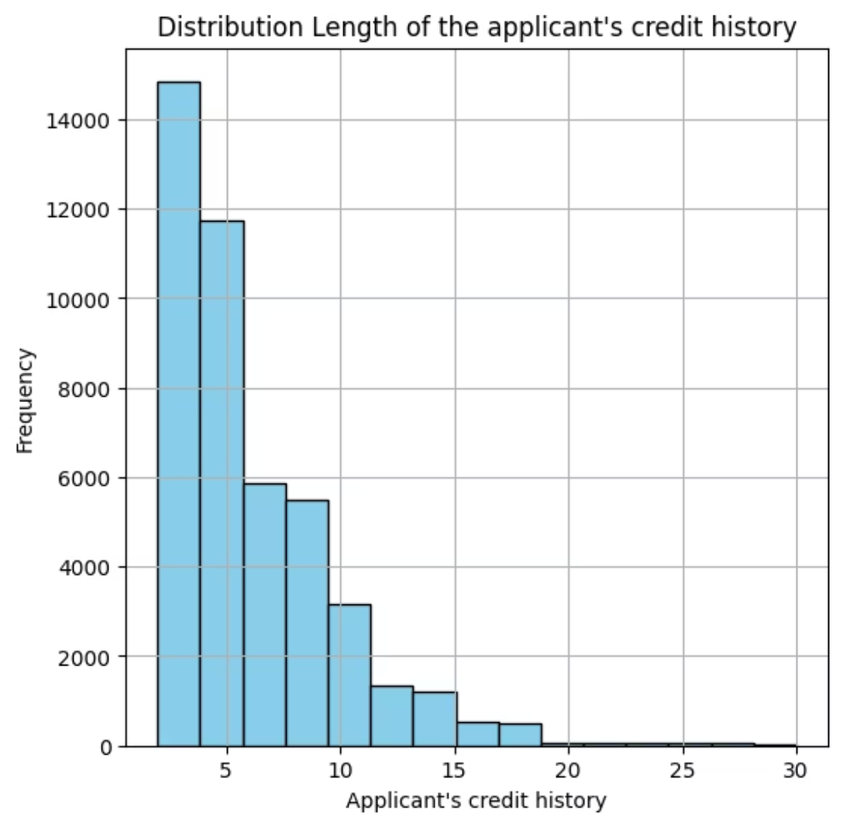
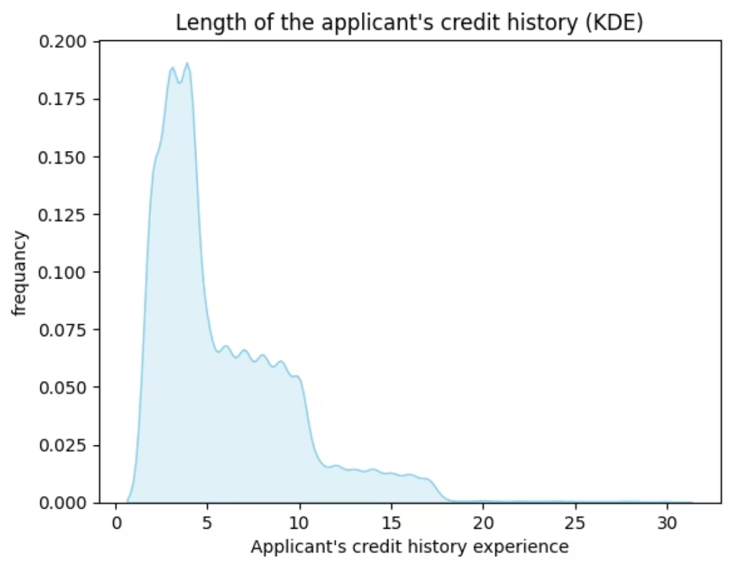
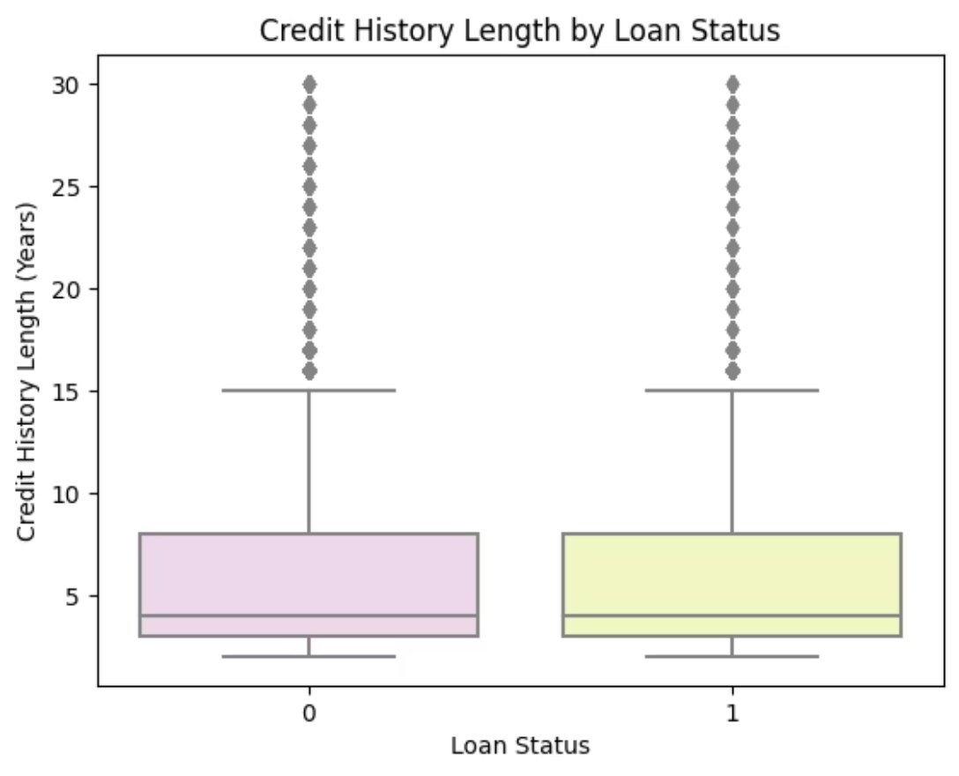
CREDIT HISTORY DISTRIBUTION :
KDE
BOX PLOT
BETWEEN CREDIT HISTORY AND LOAN STATUS
HISTOGRAM
DISTRIBUTION BETWEEN LENGTH OF THE APPLICANT'S CREDIT HISTORY AND LOAN STATUS SHOWS THAT CREDIT HISTORY HAVE A CLEAR EFFECT ON LOAN STATUS THAT APPLICANTS WITH SHORTER CREDIT HISTORY ARE MORE LIKELY TO DEFAULT
DISTRIBUTION OF LENGTH OF THE APPLICANT'S CREDIT HISTORY (in years) SHOWS THAT MOST COMMON CREDIT HISTORY OF APPLICANTS IS FROM 2~6 YEARS

Slide 16
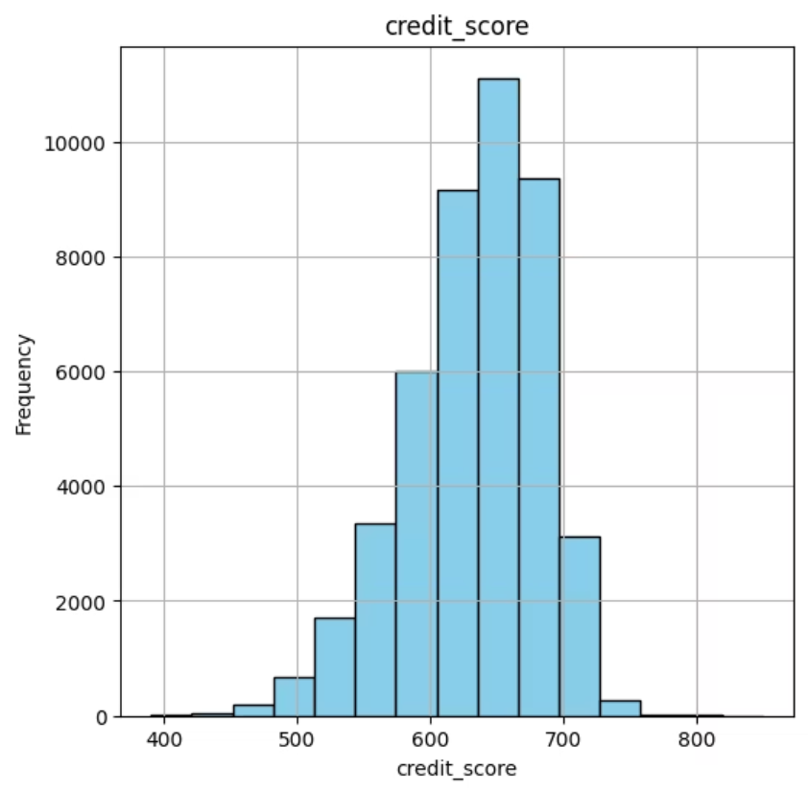
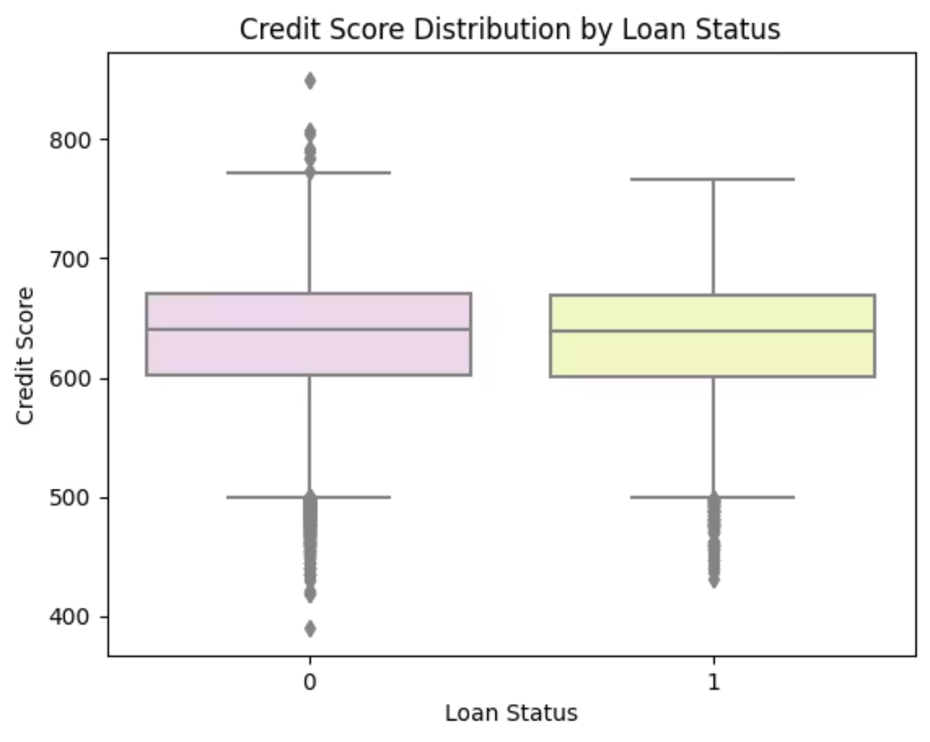
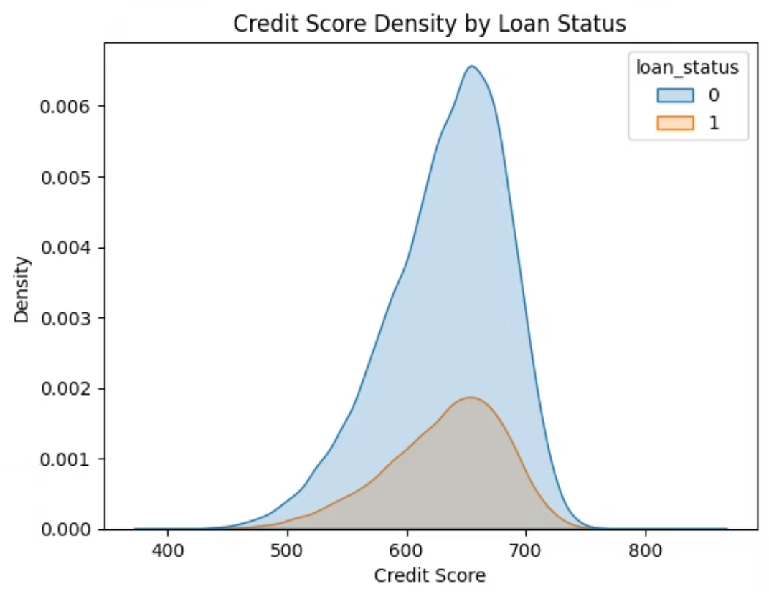
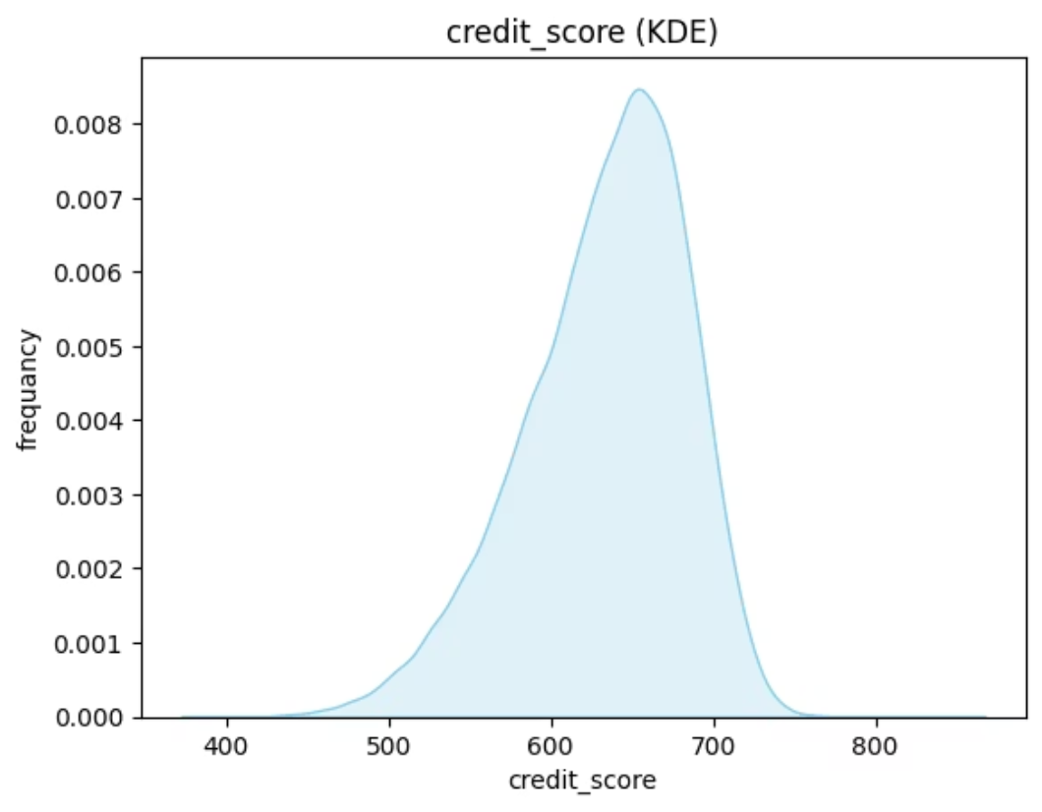
CREDIT SCORE DISTRIBUTION :
HISTOGRAM
BOX PLOT AND KDE
DISTRIBUTION OF CREDIT SCORE OF THE APPLICANTS SHOWS THAT FROM 600~700
BETWEEM CREDIT SCORE AND LOAN STATUS
DISTRIBUTION BETWEEN CREDIT SCORE AND LOAN STATUS SHOWS THAT THERE IS A CLEAR RELATIONSHIP BETWEEN CREDIT SCORE AND LOAN DEFAULT RISK THAT APPLICANTS WITH HIGHER CREDIT SCORE HAVE A LOWER DEFAULT RISK

Slide 17
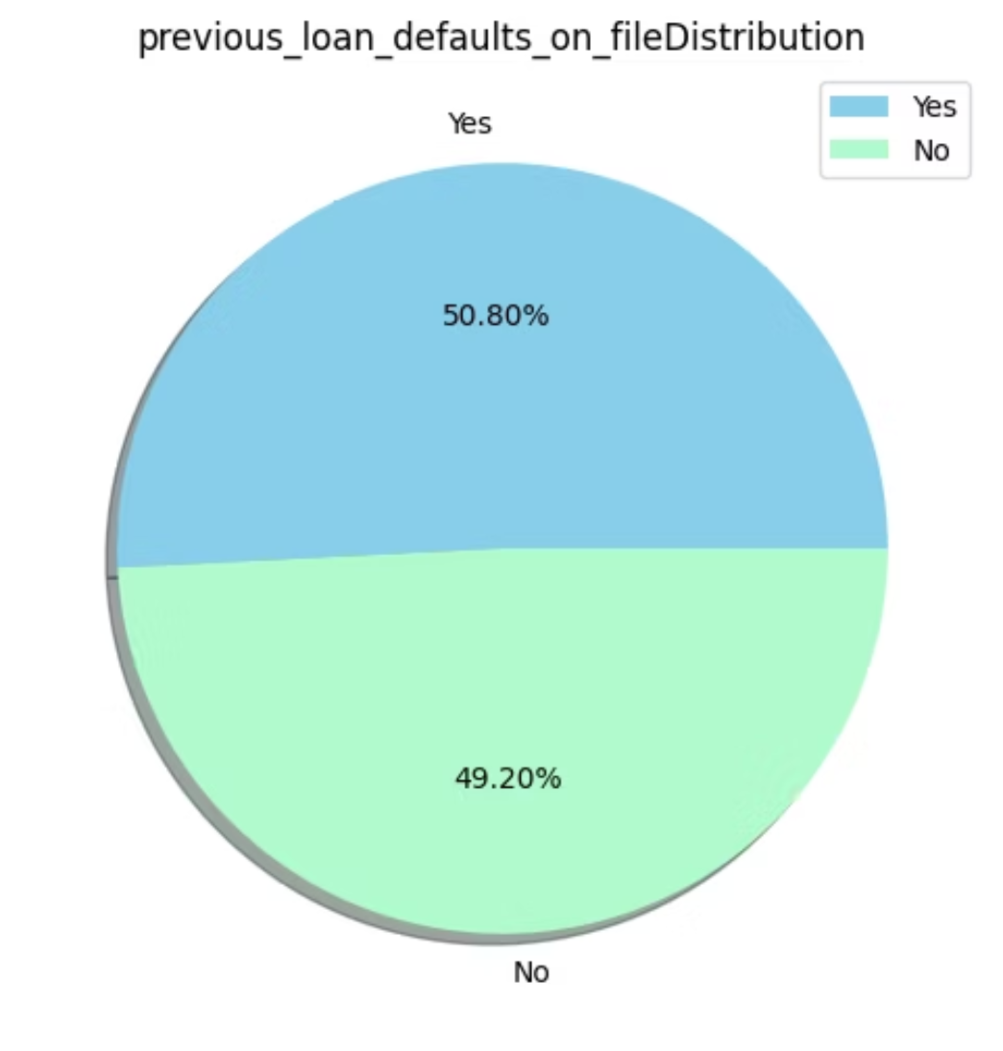
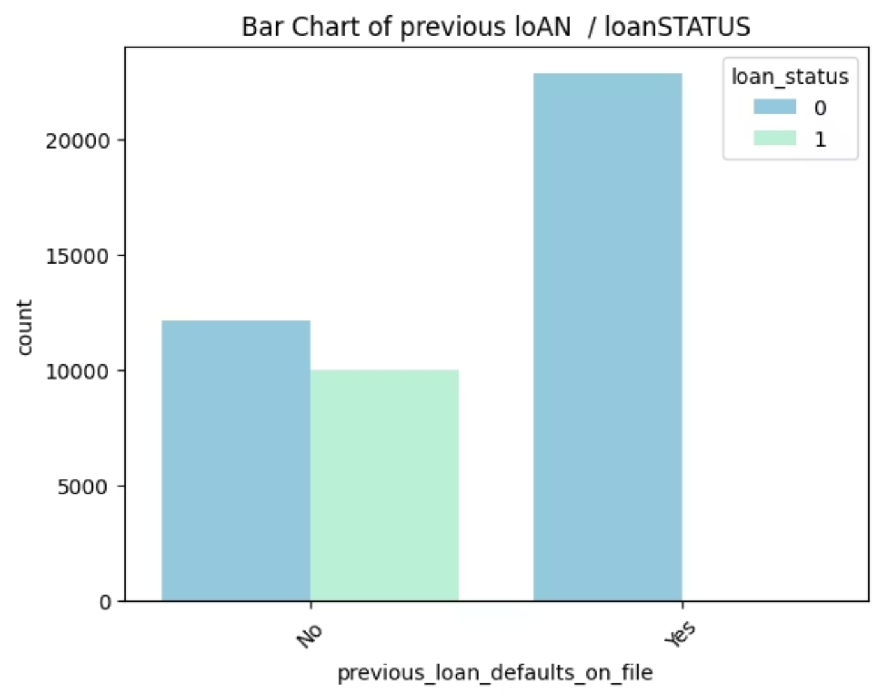
PREVIOUS LOAN DISTRIBUTION :
PIE CHART
BAR CHART
DISTRIBUTION OF WHETHER THE APPLICANTS HAVE PREVIOUS LOAN DEFAULTS SHOWS THAT THE PERCENTAGE IS EVENLT SPLIT THAT NEARLY HALF OF THEM HAD PREVIOUS LOANS DEFAULTS
BETWEEN PREVIOUS LOAN AND LOAN STATUS
DISTRIBUTION BETWEEN PREVIOUS LOAN DEFAULTS AND LOAN STATUS SHOWS THAT APPLICANTS WITH PREVIOUS LOAN DEFAULT NEARLY DO NOT HAVE ANY CHANCE TO REPAY THE LOAN AND THAT MEANS THESE APPLICANTS ARE A HIGH RISK

Slide 18
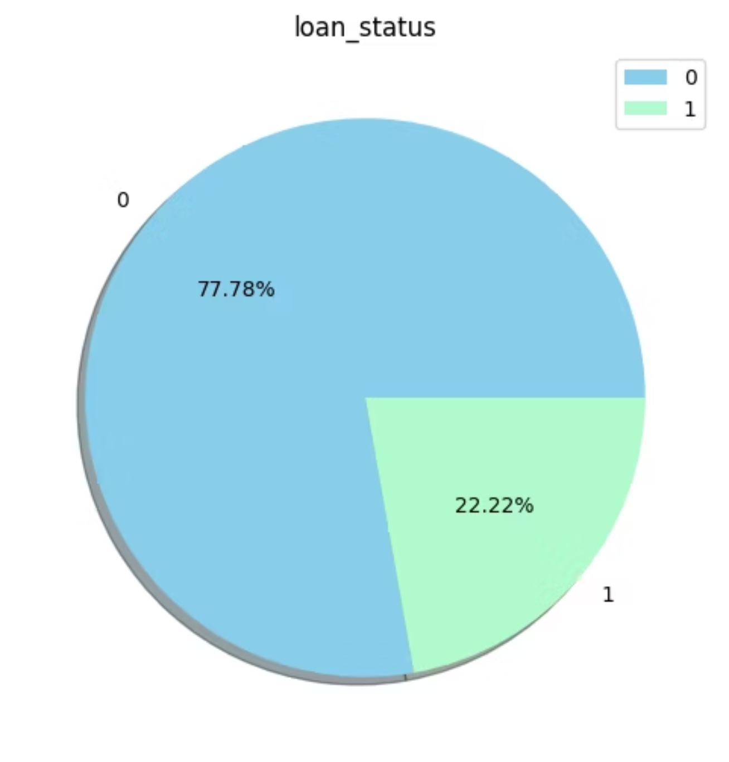
LOAN STATUS DISTRIBUTION :
PIE CHART
DISTRIBUTION OF LOAN STATUS SHOWS THAT MOST APPLICANTS UNFORTUNATLY COULD NOT REPAY THE LOAN

Slide 19
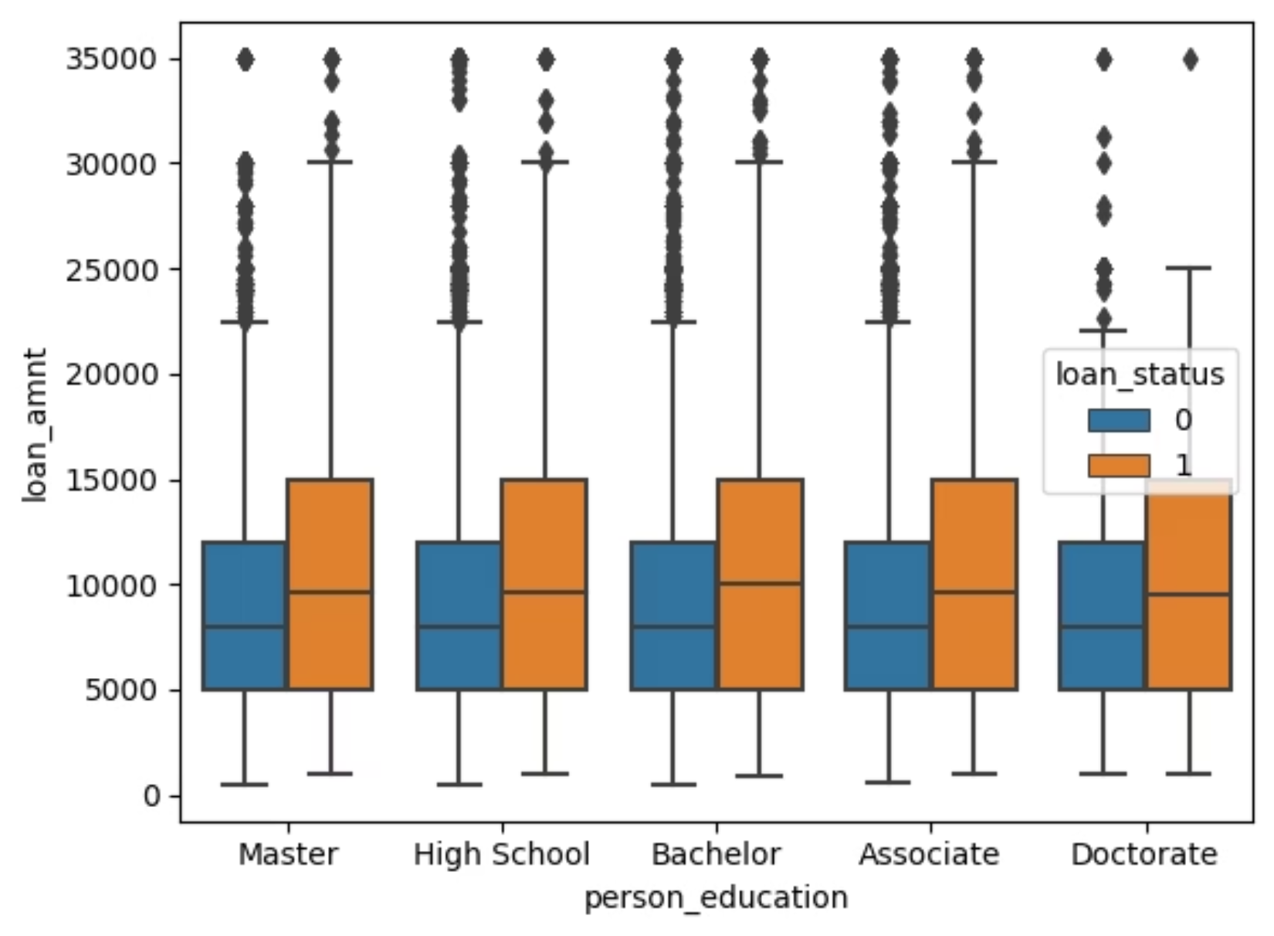
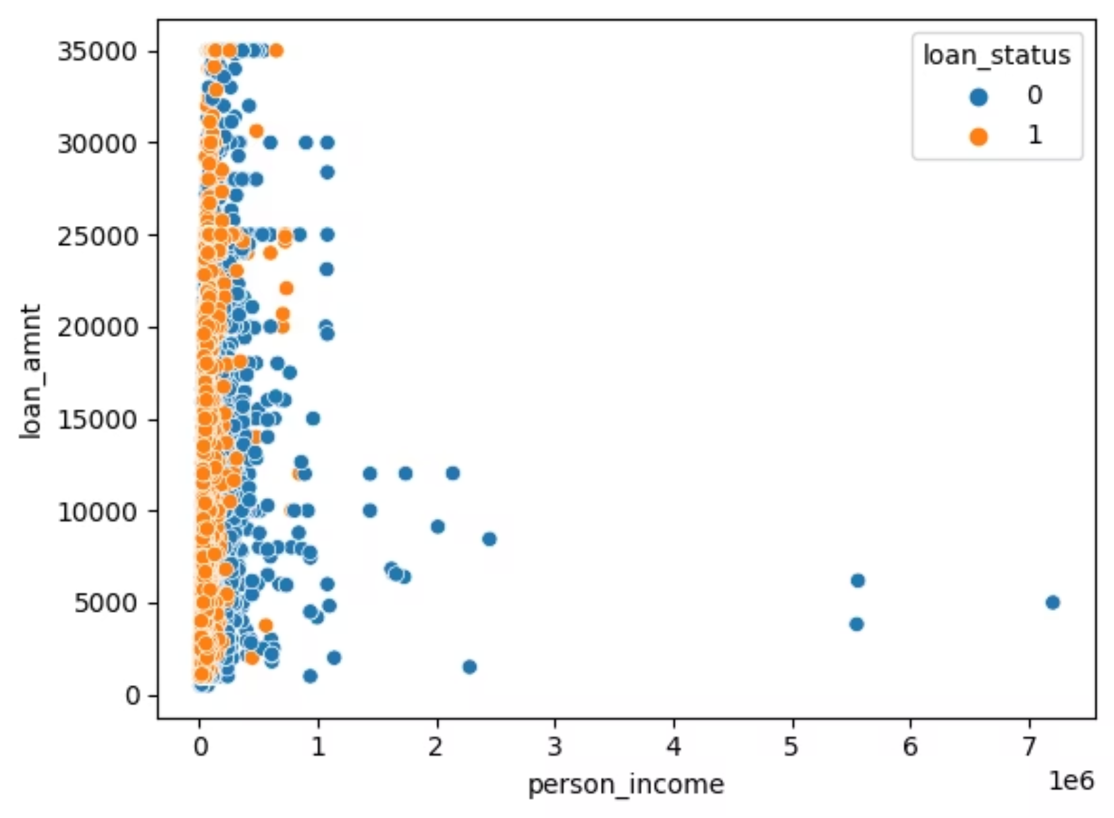
BOX PLOT
SCATTER PLOT
BETWEEN EDUCATION AND LOAN AMOUNT AND LOAN STATUS
BETWEEN INCOME AND LOAN AMOUNT AND LOAN STATUS

Slide 20
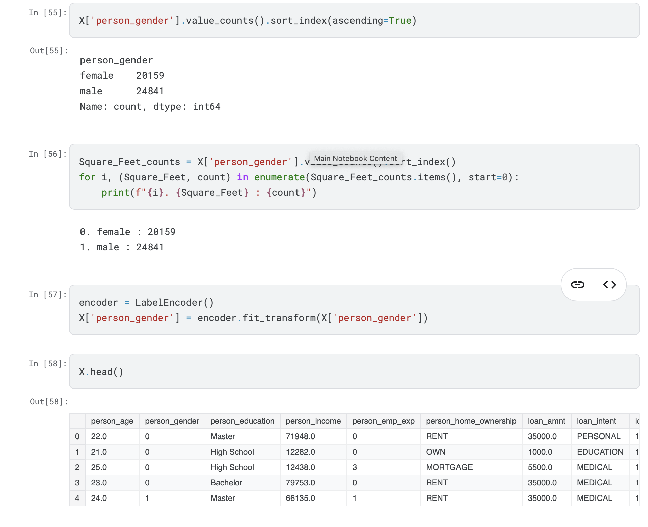
Data Preprocessing
Encoding categorical variables

Slide 21
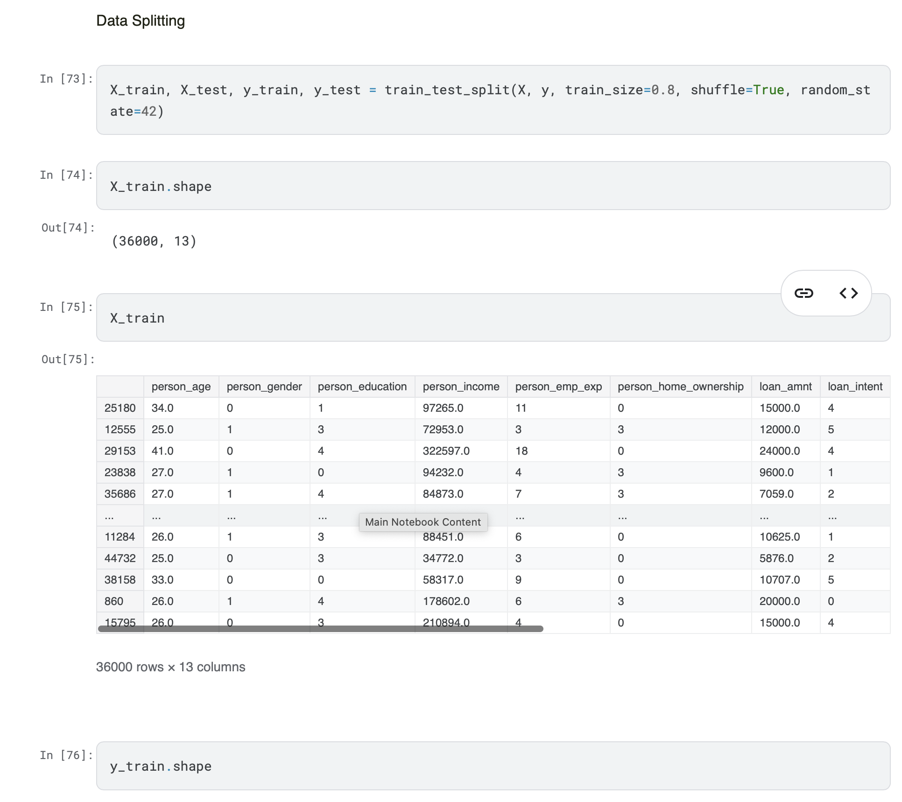
Train-Test Split

Slide 22
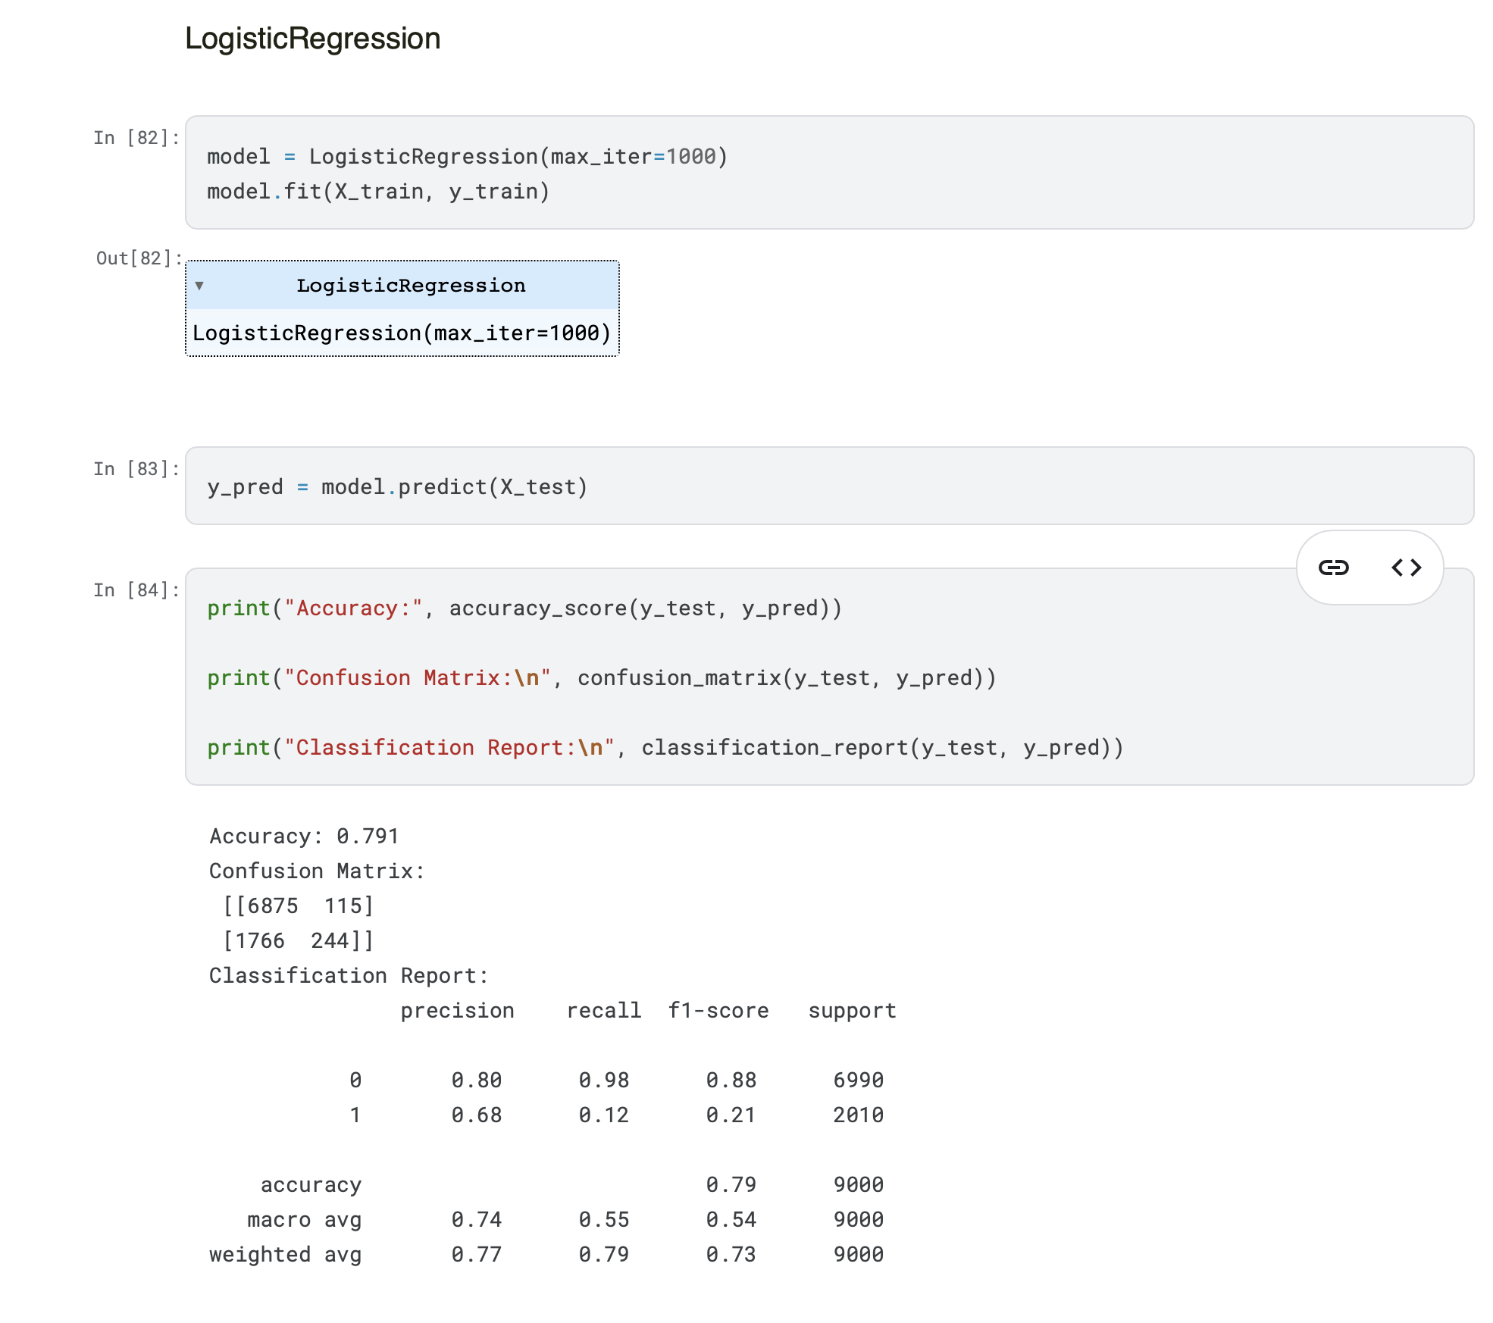
Classification Models Used
1.logistic regression

Slide 23
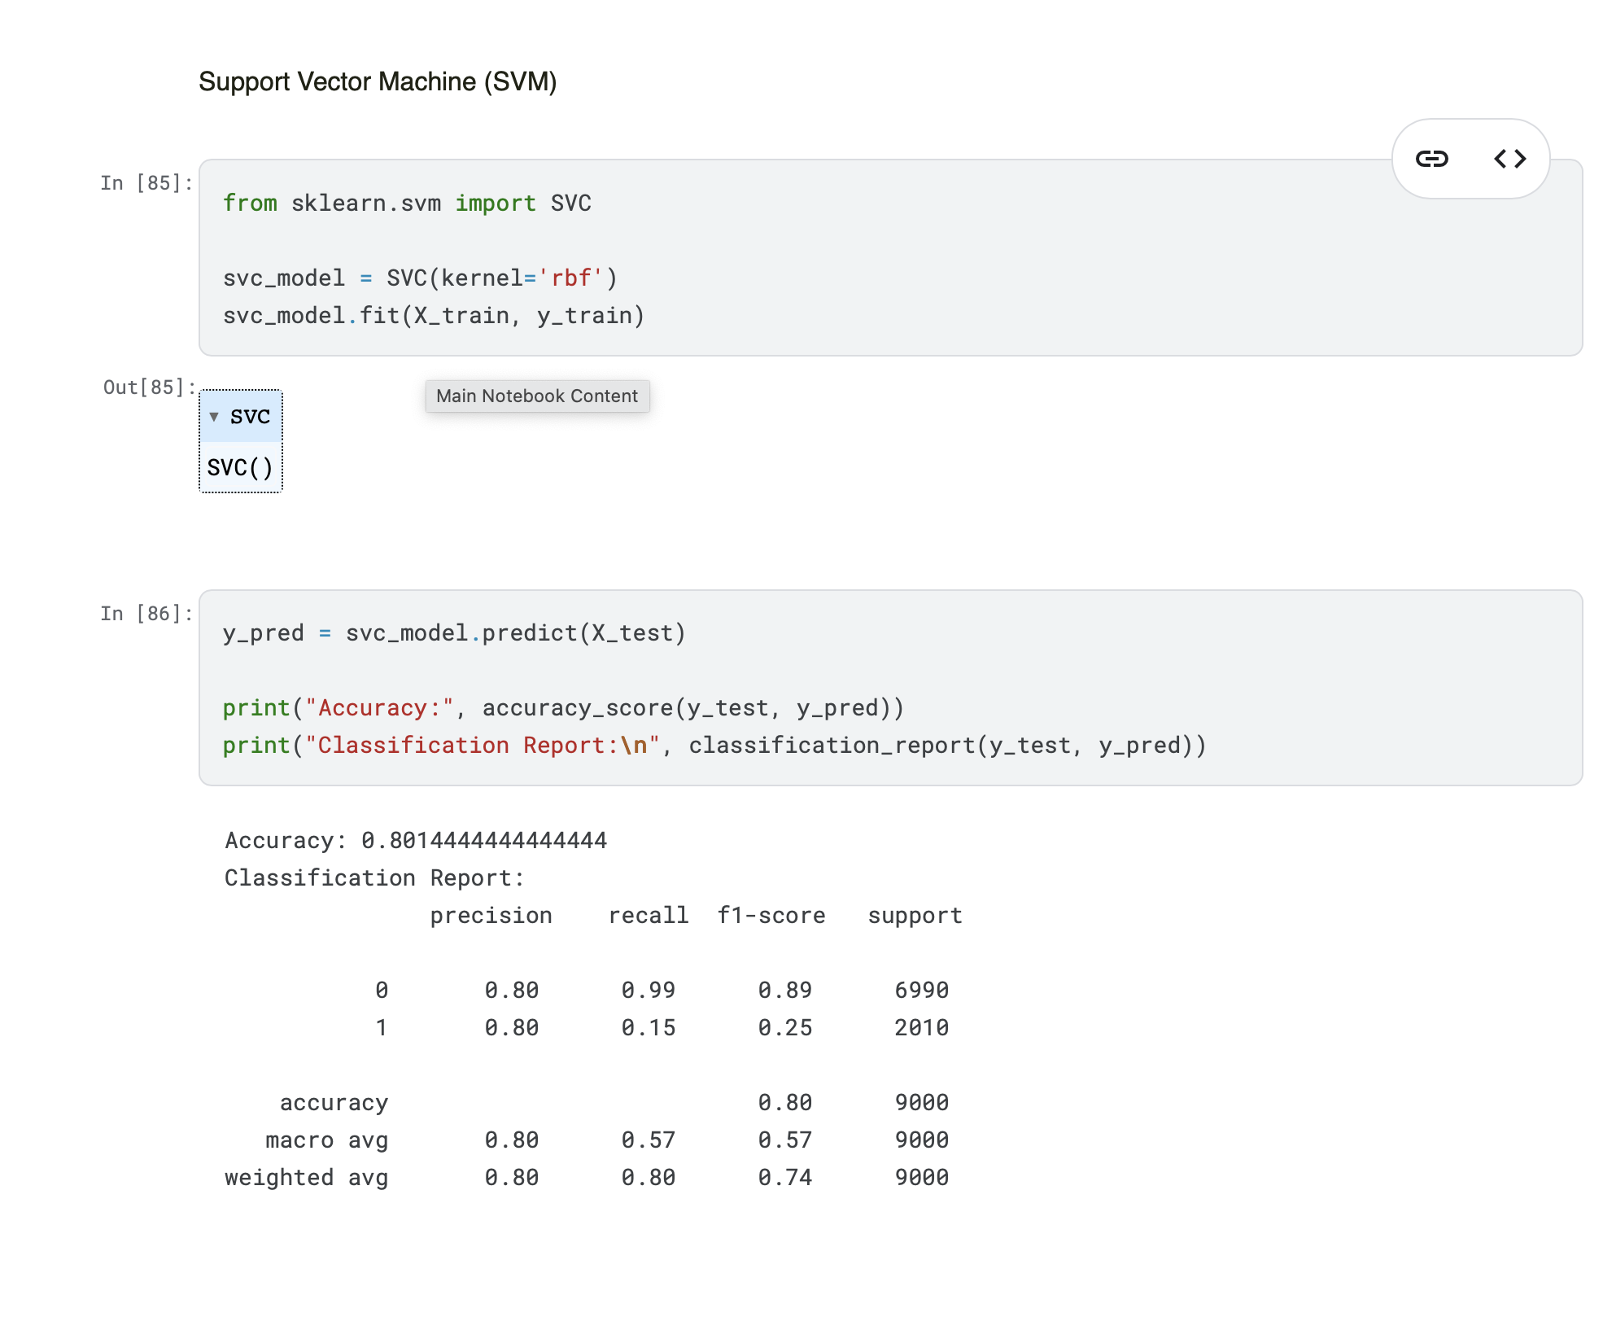
Support Vector Machine (SVM)

Slide 24
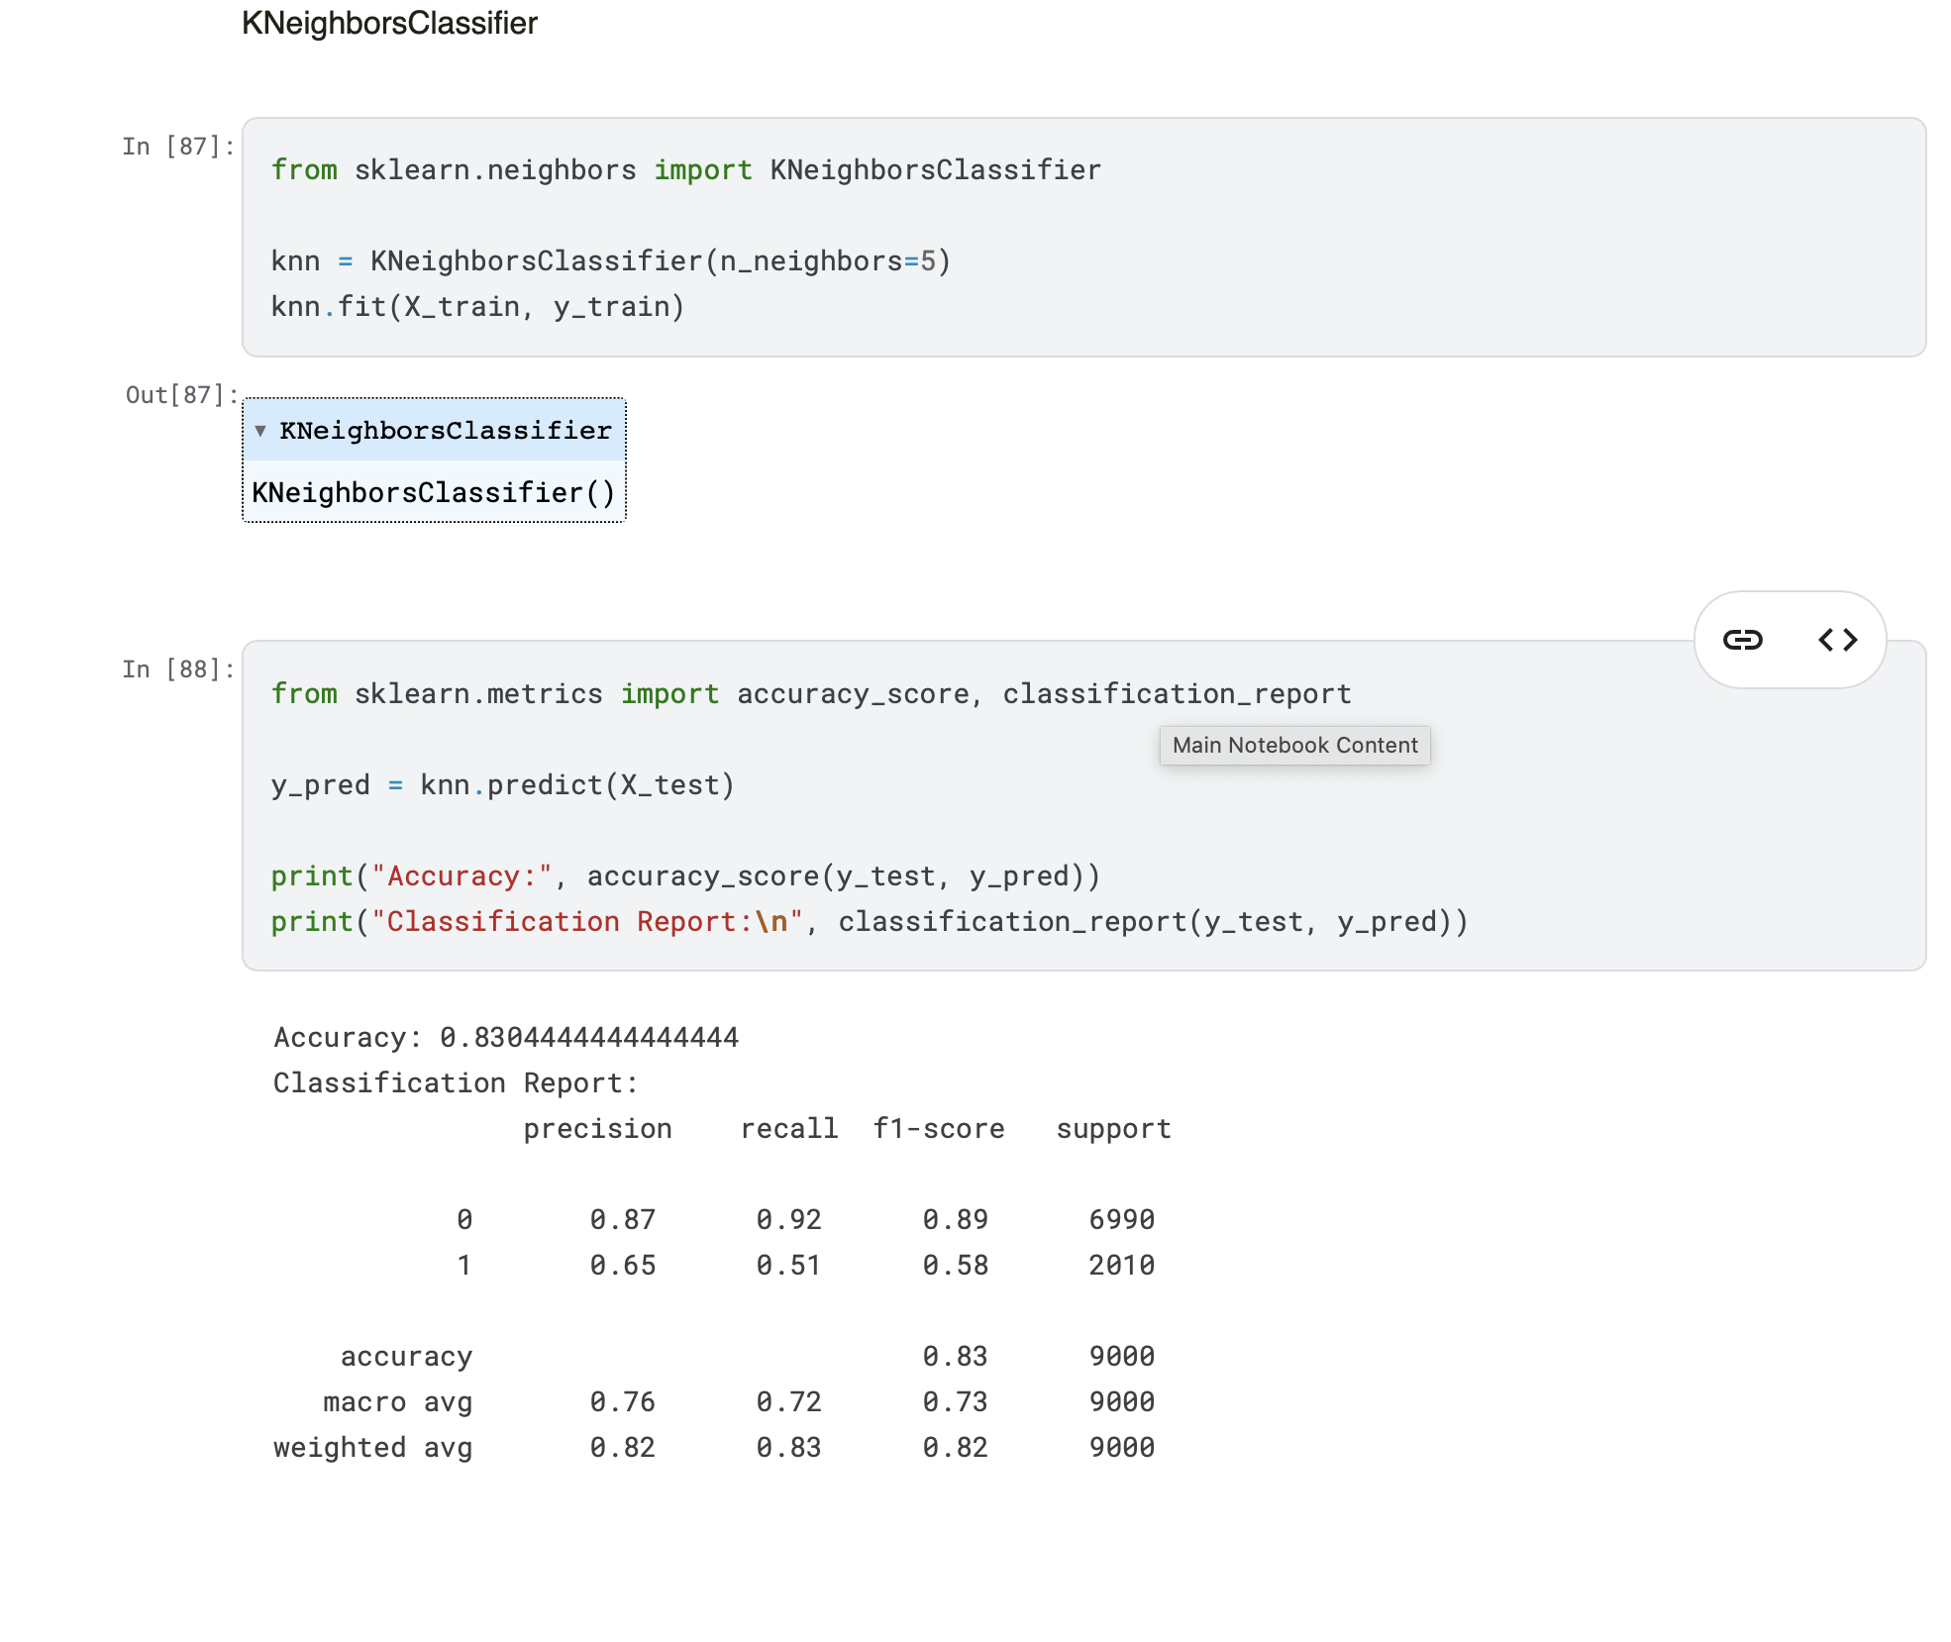
KNeighborsClassifier

Slide 25
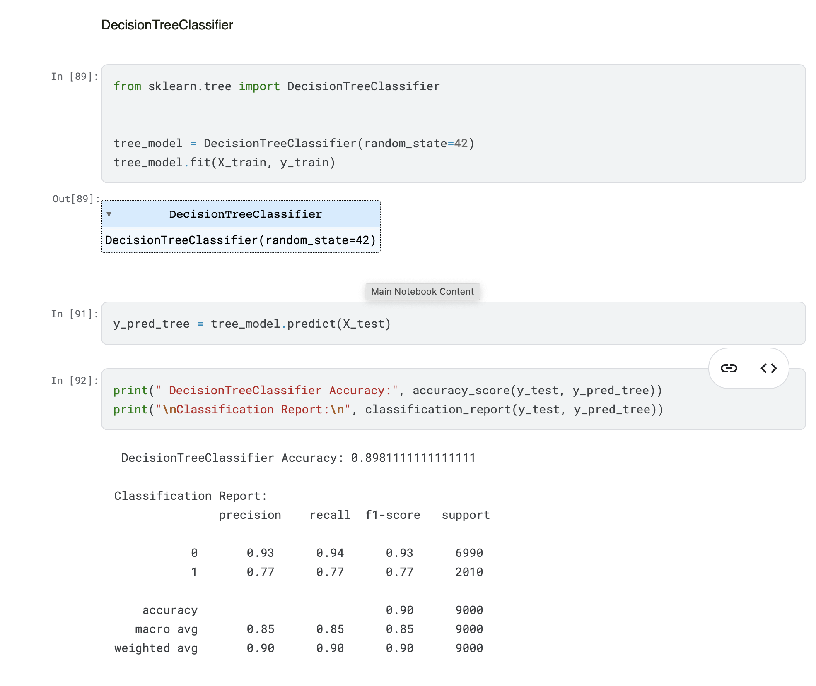
DecisionTreeClassifier

Slide 26
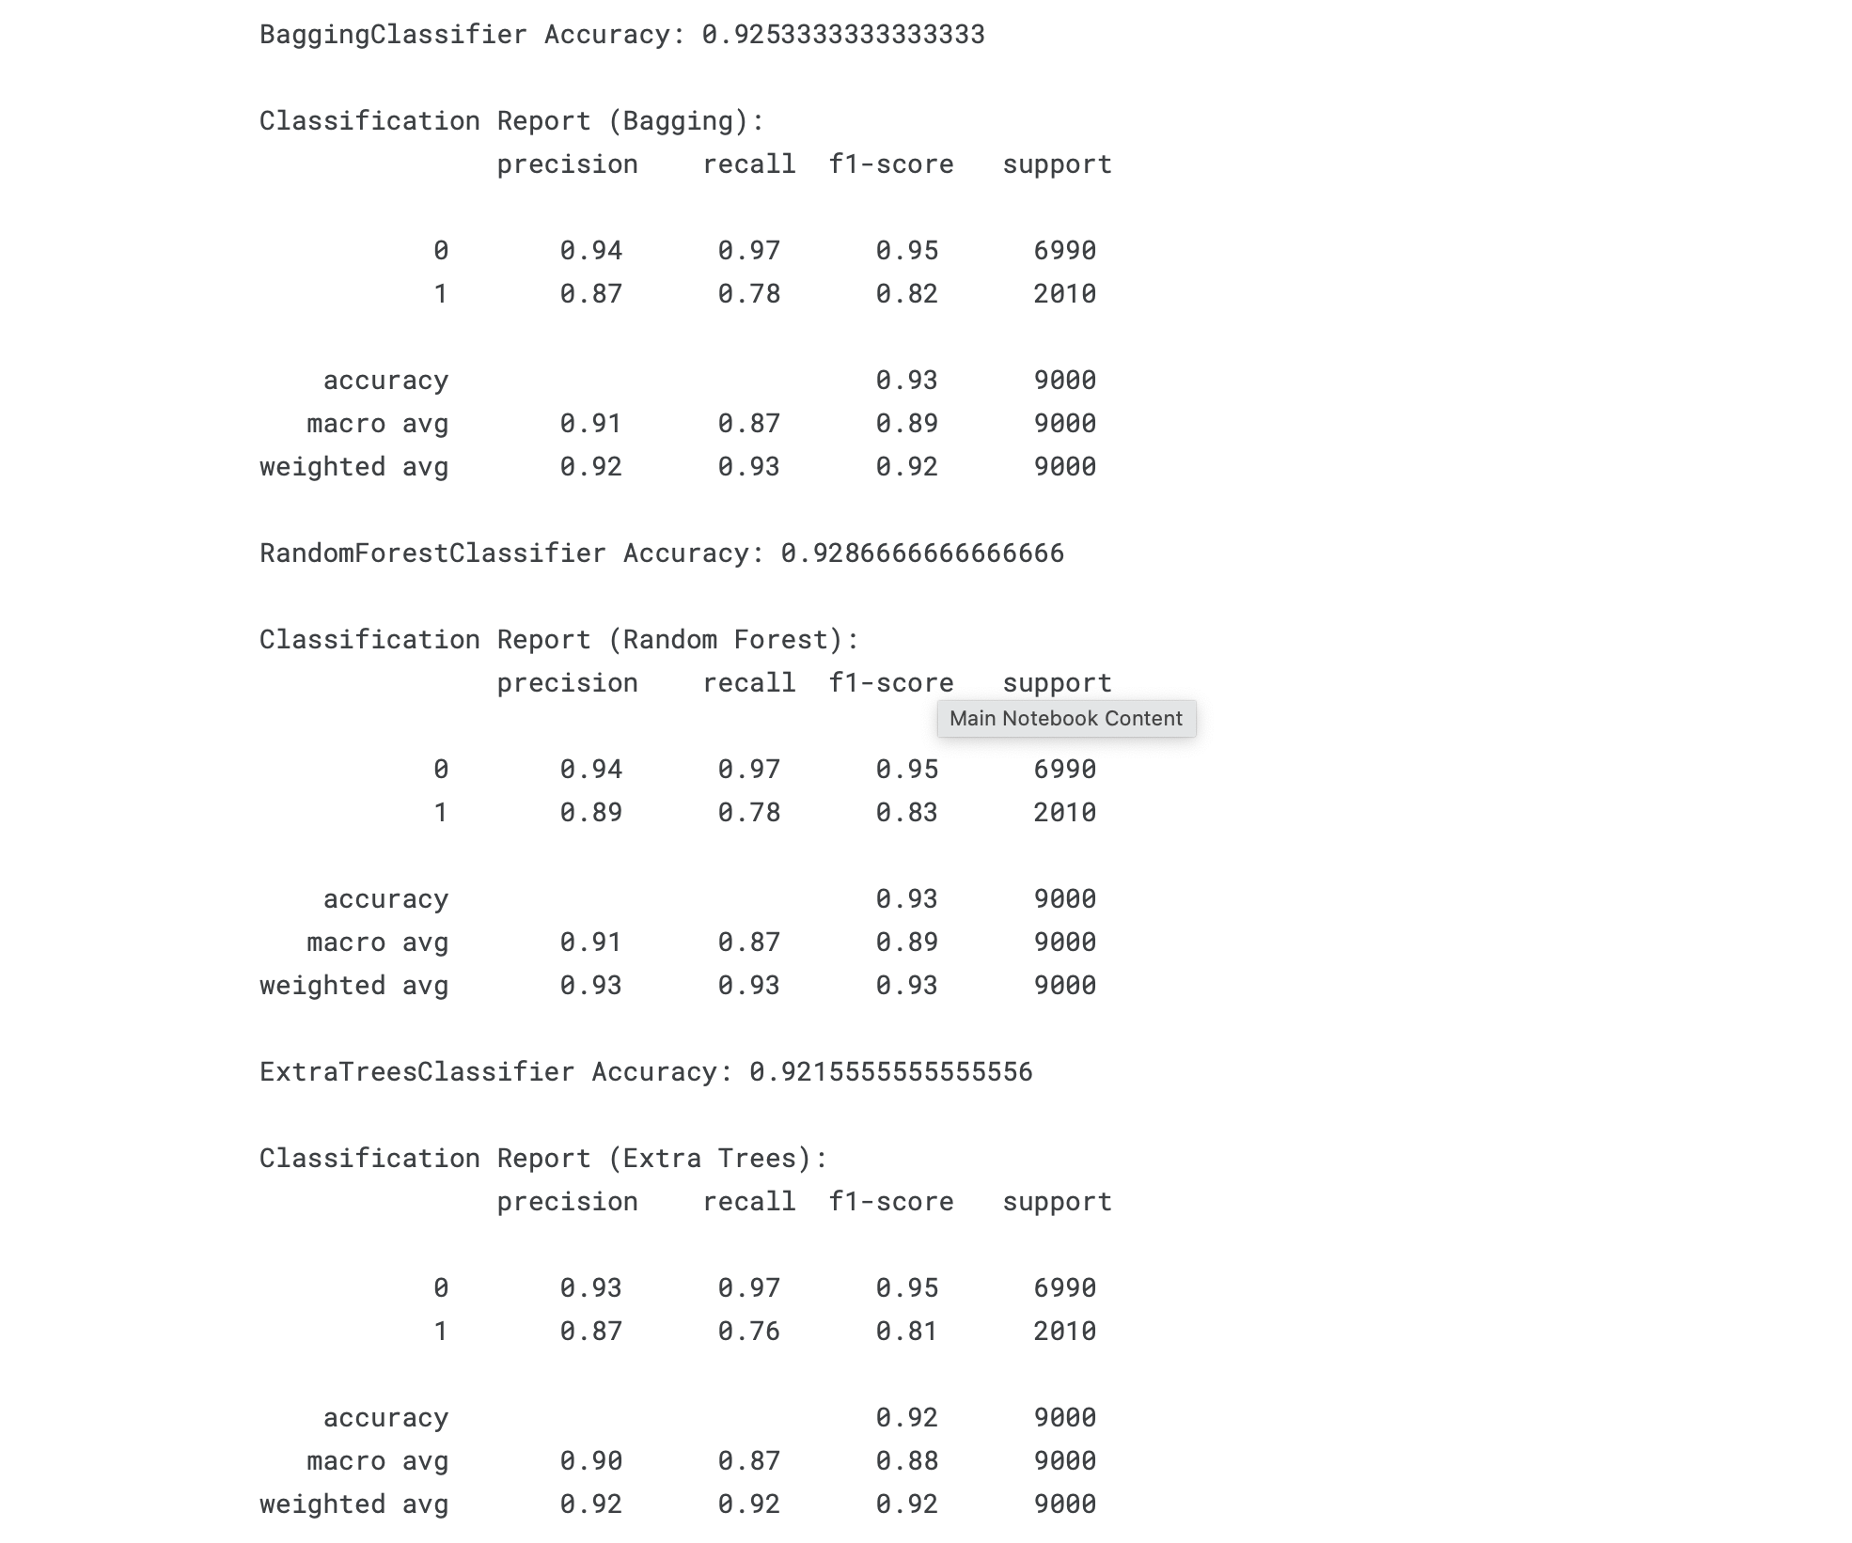
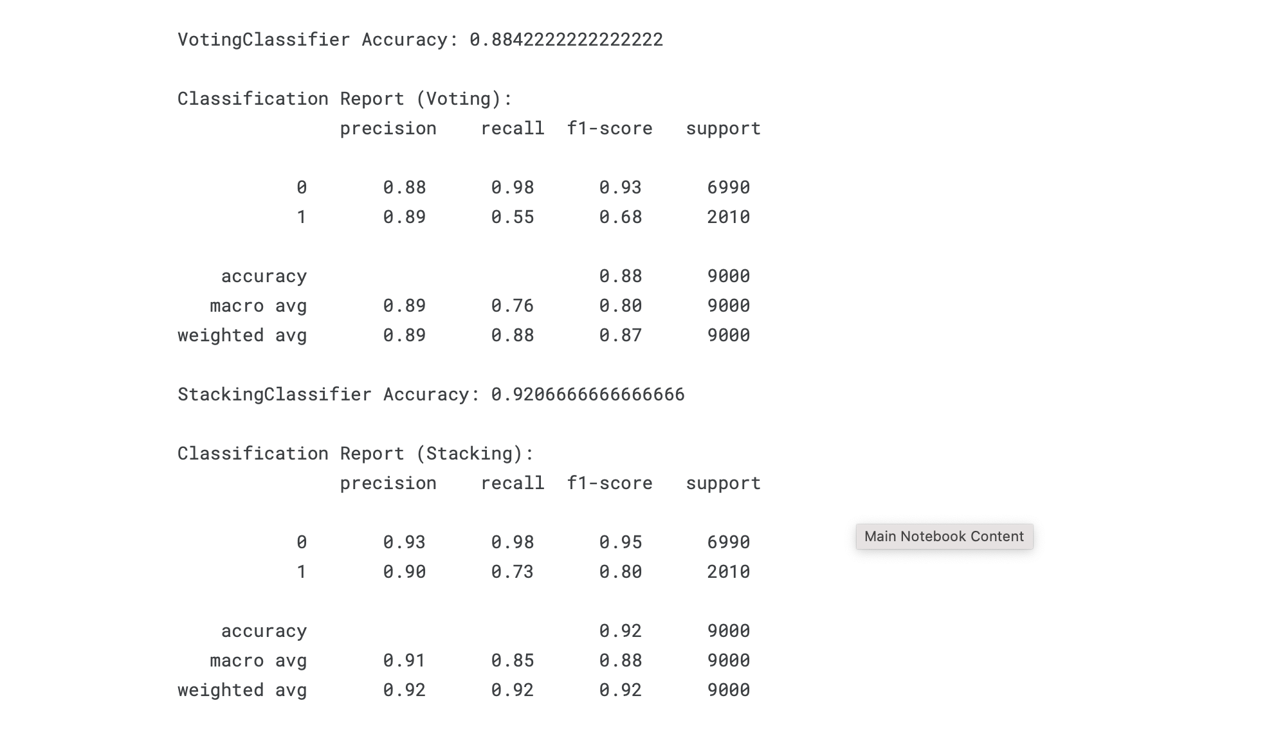
Model Evaluation

Slide 27
Data Preprocessing Steps
To prepare the data for modeling, we performed several key cleaning and transformation steps to ensure quality and efficiency.
Dimensionality Reduction
Feature Engineering
Handle Missing Values
Label-encoded categorical features like employment status to convert them into a numerical format.
Dropped irrelevant columns and features with low variance to simplify the model and improve performance.
Checked for and handled any missing data points to maintain dataset integrity.

Slide 28
Machine Learning Models
We utilized several binary classification models to predict loan default. The performance of ensemble methods was notably superior.

Slide 29
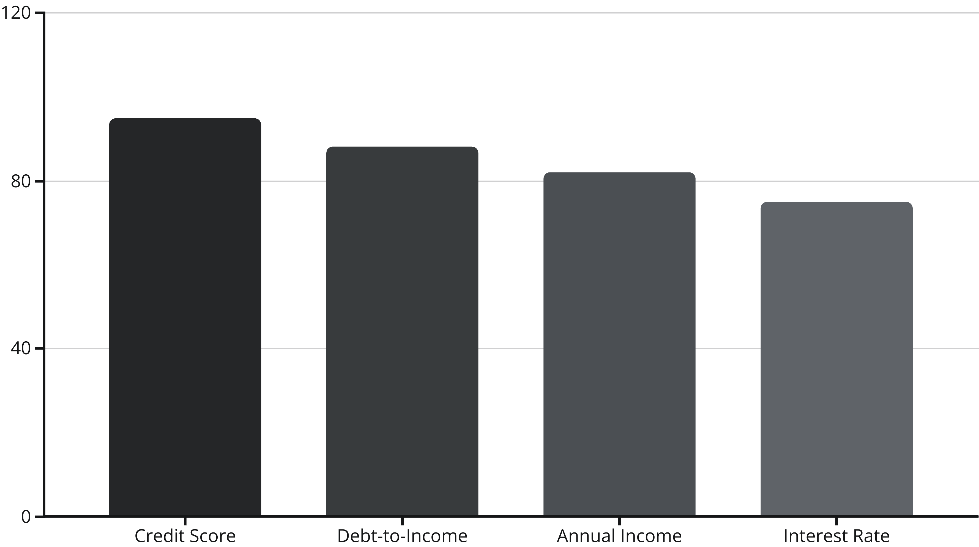
Key Results & Insights
Our analysis revealed that ensemble models like XGBoost are highly effective for this classification problem. The most influential factors in predicting default were identified.

Slide 30



Conclusion & Applications
This analysis demonstrates the power of machine learning in finance. By accurately predicting loan defaults, lenders can significantly improve their risk management strategies.
Better Credit Assessment
Targeted Interventions
Improved Profitability
Enhance decision-making by identifying high-risk applicants with greater accuracy.
Proactively offer support or adjusted terms to borrowers at risk of defaulting.
Minimize losses from defaults, leading to a healthier and more profitable lending portfolio.

